Slide 1
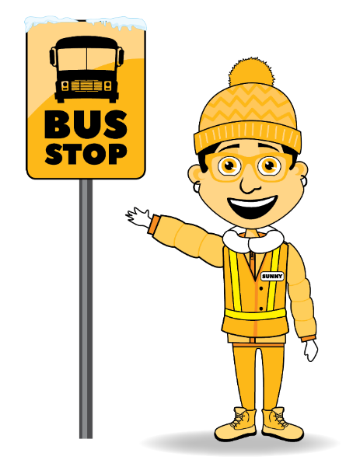
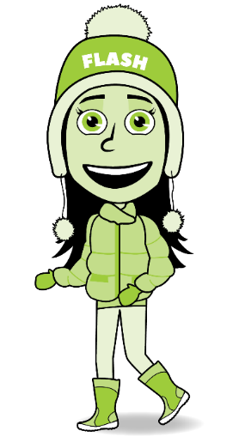
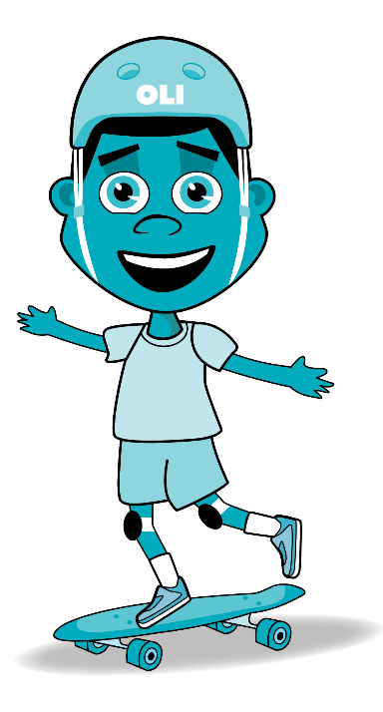
Simcoe Muskoka AST Project
Regional Report
Highlights from AST School
Data Collection
AST Steering Committee Feb. 22, 2021

Slide 2
Purpose of this Presentation
To provide a regional summary of data collected, including:
Family Survey
Student Travel Survey
Traffic Observations
Community Walkabout
To discuss implications / next steps

Slide 3
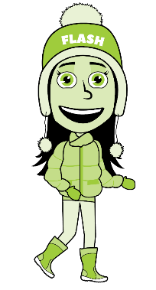
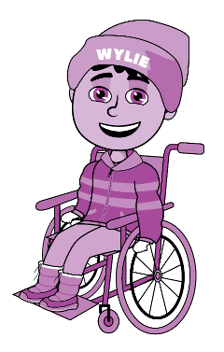
School Profile Summary
School Profile Summary
# of schools: 17
Grades served: K – 8
Total # of student enrolled: 7,247
Estimated # of families: 5,051 families
:

Slide 4
Bus Zone Summary
% of students who live in the “Bus Zone”: 35.1%
% of students in the ‘Bus Zone’ riding the school bus to school: 47.3%
% of students in the ‘Bus Zone' riding the school bus from school: 49.3%
Things to consider: Increase the # of students who live in the “Bus Zone” riding the bus
to and from school

Slide 5
Walk Zone Summary
% of students who live in the ‘Walk Zone: 64.4%
% of students in the ‘Walk Zone' walking all the way or part of the way to school: 38.4%
% of students in the ‘Walk Zone' walking all the way or part of the way from school: 40.6%
Things to consider: Increase the # of students who live in the “Walk Zone” walking to and
from school

Slide 6
Top Three Transportation Methods
To and From School (Student Travel Survey)
To School From School
1. Car (Just my family) (38.7%) 1. Walked all the way (34.9%)
2. Walked all the way (31.3%) 2. Car (Just my family) (34.5%)
3. School bus (23.8%) 3. School bus (25.2%)
Things to consider: Increase walking (AST), increase bus ridership, decrease travel to school by car

Slide 7
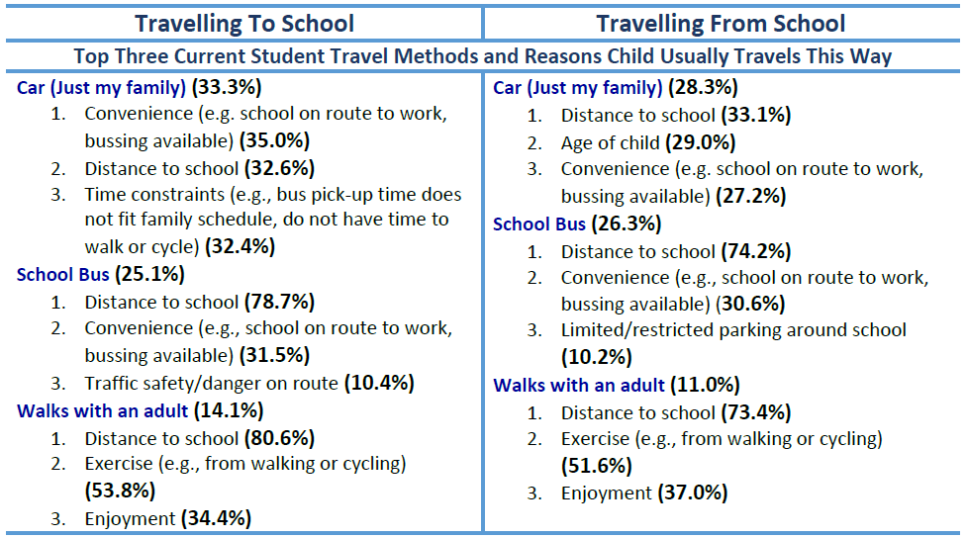
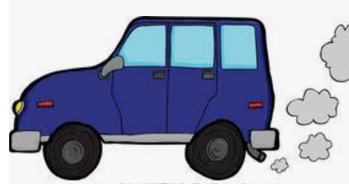
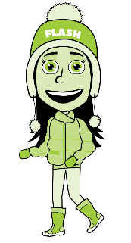
Top Three Student Travel Methods
and Reasons Why (Family Survey)
Things to consider: Consider ways to make AST more appealing and improve perception of time constraints and convenience. Consider ways to raise awareness of health benefits of AST

Slide 8
Top Three Ways to Encourage AST (Family Survey)
Things to consider: Organize walking school bus or other ways for children to walk with others, improve AST infrastructure in school neighbourhoods, reduce vehicles in school zones

Slide 9
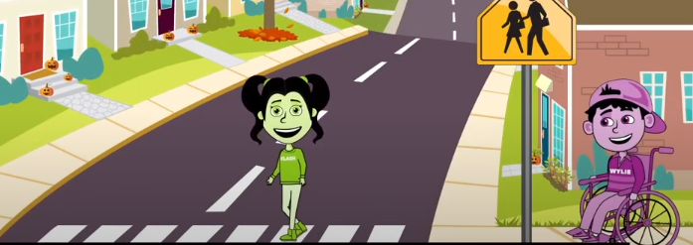
Top 3 Areas of Concern (Family Survey)
Things to consider: Consider ways to work with municipal decision makers to improve AST infrastructure and traffic enforcement

Slide 10
Walkabout and Traffic Observation
Areas of Concern
Traffic congestion in school zones Safety in school zones (cars driving too fast, not stopping at intersections and stop signs) Drivers not following rules (parked in bus area, parking in no stopping and no parking zones, double parked, dangerous U and 3 point turns, parking in resident driveways) Students not following rules (jay walking, running between cars, walking through bus area, getting out of car at intersection or on roadway) Kiss and Ride issues No cross walks, no signage and crossing guards Vehicles idling, some left unattended Lack of sidewalks and safe bicycle routes Lack of proper road and parking signage Lack of accessibility signage Unsafe and poorly maintained walking paths Poor winter maintenance of walking route Snow blocking sidewalks and blocking visibility Crosswalks not visible enough

Slide 11
Implications and Next Steps
Increase the # of students who live in the “Bus Zone” riding the bus to and from school Increase the # of students who live in the “Walk Zone” walking to and from school Increase walking (AST), increase bus ridership, decrease travel to school by car Consider ways to make AST more appealing and improve perception of time constraints and convenience. Consider ways to raise awareness of health benefits of AST Organize walking school bus or other ways for children to walk with others Reduce vehicles in school zones Improve safety in school zones Consider ways to work with municipal decision makers to improve AST infrastructure and traffic enforcement Consider how to address these issues using the 5Es of AST Consider how to use this information in a regional communication campaign Other?

Slide 12
Thank you!

