Slide 1
Omicron Interim Guidance for Licensed Child Care Centres Key Messages for Operators & Staff
*Current as of March 10, 2022

Slide 2
OBJECTIVES
Provide updates from Ministry Guidance for COVID-19 Omicron Surge
1
Outline provincial measures for child care settings
2
Review current testing and self-isolation guidance
3

Slide 3
REPORTING TO PUBLIC HEALTH
The Ministry of Education has suspended the reporting of COVID-19 cases to public health for schools and child care centres. Centres are asked to report “above baseline” levels of illness per usual.
Public health units will no longer be dismissing cohorts. Any dismissals or closures of a child care setting will be contingent upon operational requirements determined by the child care operator.

Slide 4
UPDATE - TESTING
PCR testing has been restricted to highest priority settings;
- children and staff from school/child care centres (CCCs) are no longer eligible at publicly funded assessment centres unless they are household contacts of workers in the highest risk settings
Current testing options include take-home PCR self-collection kits or Rapid Antigen Tests (RAT) provided to the child care centres
- SMDHU does not supply or stock take-home tests
Positive results from RAT testing no longer require confirmatory PCR testing

Slide 5
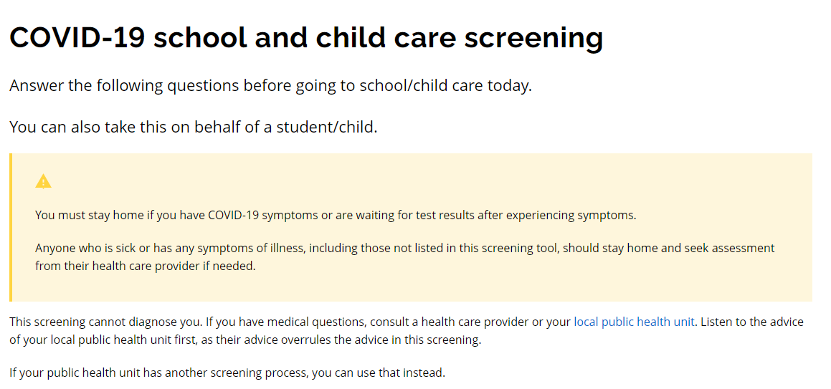
SCREENING
Provincial screening tool has been updated
Staff and children must self-screen for signs and symptoms every day
covid-19.ontario.ca/school-screening

Slide 6
SCREENING SYMPTOMS
Individuals experiencing 1+ common symptoms, or 2+ other symptoms are presumed to have COVID-19 and must isolate (regardless of vaccination status)
Common symptoms (1 or more) Fever/chills Cough Shortness of breath Decrease/loss of taste or smell | Other symptoms (2 or more) Runny nose/nasal congestion Headache Extreme fatigue Sore throat Muscle aches/joint pain Gastrointestinal symptoms

Slide 7
SELF-ISOLATION: SYMPTOMATIC/CONFIRMED CASES
 | Symptomatic individual is fully vaccinated OR under 12 years of age | Symptomatic individual is 12 years of age or older AND not fully vaccinated or immunocompromised
Confirmed case (Positive on RAT or PCR) | Isolate for 5 days from symptom onset and must be fever free with symptoms improving for 24 hours (48 hours if gastrointestinal symptoms) | Isolate for 10 days from symptom onset and must be fever free with symptoms improving for 24 hours (48 hours if gastrointestinal symptoms)
Symptomatic individual
Symptomatic individuals can return to centre if they receive negative result(s) on:
1 PCR test; OR
2 RATs taken 24-48 hours apart
If not tested – must follow self-isolation as noted for confirmed case above

Slide 8
Cases Returning to Child Care
Cases who were only required to isolate for 5 days (fully vaccinated or under 12 years old) must maintain masking in public settings (such as child care) until 10 days from symptom onset unless they are under 2 years and/or have an exemption.

Slide 9
Household Members
The following household members do NOT need to self-isolate while the individual is isolating:
- Member tested positive for COVID-19 in the last 90 days
- Member is 18 years or older and has received 3 doses of vaccine (boosted)
- Member is under 18 years and has received 2 doses of vaccine (fully vaccinated)
If the household member has symptoms, they must also self-isolate and follow the guidance for cases.
If the person with symptoms meets the criteria to end their self-isolation, the remainder of the household can immediately stop isolating as long as no one else has symptoms or is a case/contact
If household members have to self-isolate, they are asked not to visit a highest risk setting for 10 days from their last exposure to the case or symptomatic individual

Slide 10
ISOLATION WITH OTHER SYMPTOMS
Individuals with a symptom not listed below or only one of the following symptoms should isolate until symptoms have been improving for 24 hours (48 hours for gastrointestinal symptoms):
Runny nose/nasal congestion
Headache
Extreme fatigue
Sore throat
Muscle aches/joint pain
GI symptoms
Household members do not need to self-isolate.

Slide 11
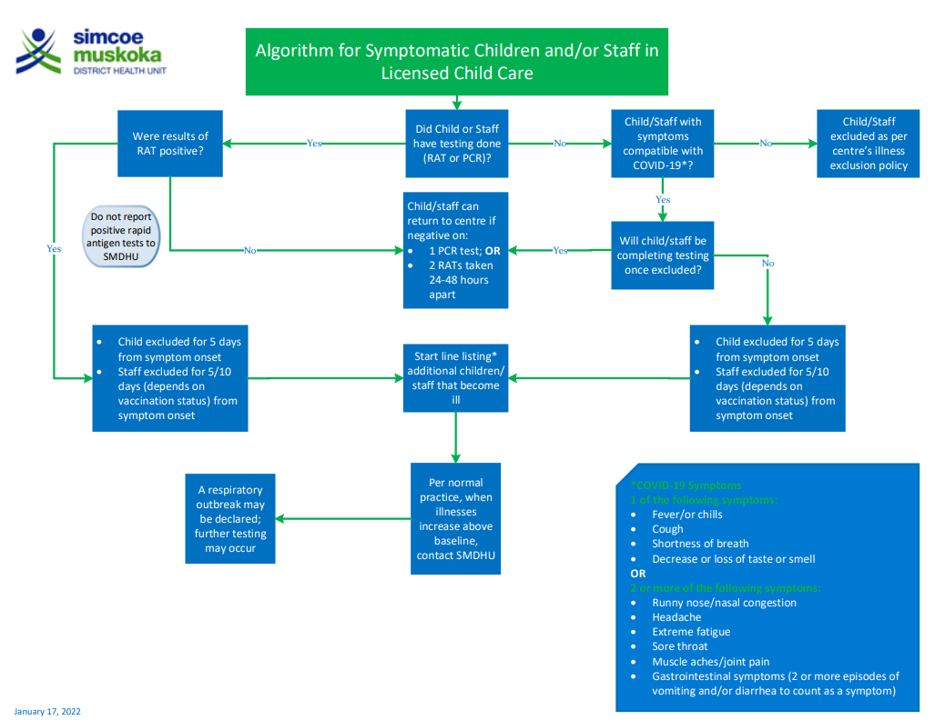
Symptomatic Individuals Algorithm
Resource to guide decision-making regarding exclusion and return to child care
Available at: https://www.simcoemuskokahealth.org/HealthUnit/Workplaces/Businesses/ChildCare/COVID-19-Information

Slide 12
Conclusion and Key Takeaways
Omicron is highly transmissible and has resulted in unprecedented case counts in our community and around the world
Requires a shift in strategy to protect the most vulnerable (e.g., those in long-term care, congregate living settings), who are at risk of severe illness from COVID-19
Vaccination continues to be a safe and effective way to protect staff from severe outcomes related to COVID-19
Role of Operators is to support keeping sick children and staff out of buildings
Public Health will continue to support Operators through outbreak scenarios

Slide 13
Question #1:
If Child A is isolating because they are symptomatic or are a confirmed case, can they return to child care if they are still symptomatic?
Answer:
A student/child who is fully vaccinated OR <12 years old must isolate for five days from when symptoms started + stay in isolation until their symptoms have been improving for 24 hours (48 hours for nausea, vomiting and/or diarrhea), whichever is longest. They should not have a fever when returning. Upon return to child care, they are asked to wear a mask (unless under 2 or exempt) until it has been 10 days from symptom onset.
A student/child who is 12 years old or older + not fully vaccinated OR is immunocompromised must isolate for 10 days from when the symptoms started + stay in isolation until their symptoms have been improving for 24 hours (48 hours for nausea, vomiting and/or diarrhea), whichever is longest. They should not have a fever when returning.

Slide 14
Question #2:
If an unvaccinated adult in a household has symptoms consistent with COVID-19, how long do the children in the house need to isolate for?
Answer:
It now depends on vaccination and/or recent infection of the household members. All household members must self-isolate while the ill individual is isolating unless:
- Household member has previously tested positive for COVID-19 in the past 90 days;
- Household member is 18 years or older and has received booster dose of COVID-19 vaccine; OR
- Household member under 18 years and is fully vaccinated*.

Slide 15
Question #3:
Child A is symptomatic, <12 years old, and self-isolates for 5 days. On Day 4 of their self-isolation, another household member develops symptoms. Can Child A return to child care after their own self-isolation is complete (Day 6) or do they need to continue isolating?
Answer:
Any household member who is still well and does not have symptoms should continue self-isolating until the last symptomatic or COVID-19 positive individual in the household has finished their self-isolation period.
Child A who developed symptoms first, does not have to extend their self-isolation period based on other household members becoming ill. They may return on Day 6 to child care but will need to wear a mask unless under 2 years of age or exempt.

Slide 16
Question #4:
Will SMDHU be excluding cohorts when centres are aware of a positive COVID-19 case?
Answer:
SMDHU will not be excluding cohorts at this time. Staff and children are expected to follow the provincial screening tool and isolate/monitor as per the direction given in the tool.

Slide 17
Question #5:
Are centres supposed to notify families when aware of a case in a cohort?
Answer:
SMDHU will no longer be requesting operators inform families of a known case in their cohorts. Additional communication is at the discretion of the operator. Please follow up with your Program Advisor further if you have more questions in this regard.

Slide 18
Question #6:
What is our baseline illness rate? What if we do not know what our baseline number is?
Answer:
Baseline illness is the number of children and/or staff normally absent from the centre due to illness (by cohort). This should be based on your daily health records/attendance over the past 2 years. If your baseline is unknown, centres may default to either 30% absent (from a cohort) due to illness or when 3 or more in a cohort are ill with similar symptoms within a 48-hour period. Centres do not have to wait until 30% of children/staff are ill to contact the SMDHU.

Slide 19
Question #7:
When is vomiting and/or diarrhea considered a symptom? If a child has one episode of vomiting or loose stool, are they to be excluded for 24 or 48hrs?
Answer:
For vomiting/diarrhea to be considered a symptom, the individual needs to have at least two or more episodes of vomiting and/or loose stool. The centre’s illness exclusion policy should be followed. If the child develops any other symptom related to COVID-19, they will be required to isolate for 5 days (unless they meet the testing criteria for return).

Slide 20
Question #8:
Will a respiratory outbreak be declared based on an individual room or will it depend on what is happening within the entire centre?
Answer:
As per routine outbreak management, a respiratory outbreak may be declared in only one room when the outbreak definition is met. A centre-wide outbreak may be declared if similar symptoms and increased in number of ill are being seen in other rooms. Mixing of cohorts will play a factor in this decision.

