Slide 1
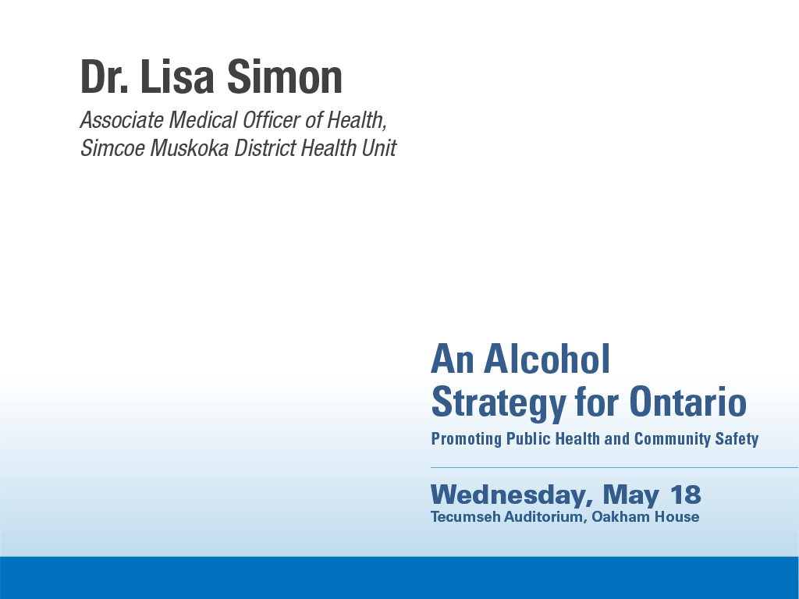

Slide 2
What are the impacts of changes in access to alcohol on vulnerable populations?
Outline:
An equity lens for alcohol policy
SES and alcohol-related harms
SES and physical availability
Policy implications

Slide 3
An equity lens for alcohol policy:
3 health equity questions
Could the planned initiative or policy approaches have a negative impact on some populations or communities? If so, how can the negative/inequitable impacts be mitigated?
How do we consider the needs of disadvantaged individuals and communities, and priority populations?
How will the planned initiatives or policy approaches address the social determinants of health?
(Wellesley Institute, 2011; alPHa-OPHA Health Equity Workgroup, 2013)

Slide 4
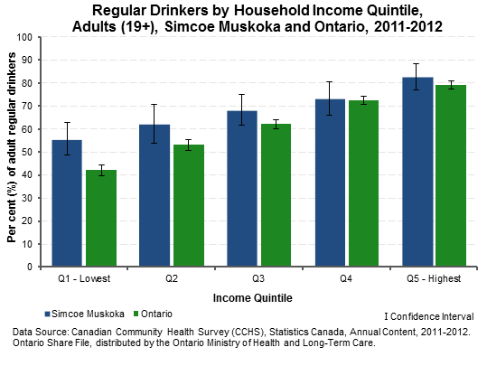

Slide 5
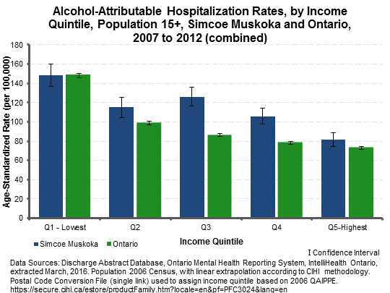
Based on methods of CIHI, 2015: Trends in Income-Related Health Inequalities in Canada
Measure | SMDHU | Ontario
Disparity Rate Ratio (Q1 ÷ Q5) | 1.8 (1.6, 2.1) | 2.0 (1.97, 2.08)
Disparity Rate Difference (Q1 − Q5) | 67.1 (53.4, 80.9) | 75.0 (72.4, 77.7)
Potential Rate Reduction (%) | 27.4 (21.5, 32.9) | 24.5 (23.1, 26.0)
Population Impact Number (PIN) | 130 | 2450

Slide 6
SES and alcohol consumption
Complex association between alcohol and socioeconomic status (SES)
Higher SES associated with more frequent drinking
Lower SES consume less alcohol overall and more likely to be abstainers, but also more likelihood of binge drinking in some studies/populations
(Roche et al, 2015; WHO, 2014; Jones et al, 2015)

Slide 7
SES and alcohol-related harm
For given level of consumption, disadvantaged groups typically have higher levels of alcohol-related harm than advantaged groups (Roche et al, 2015)
Total burden of alcohol-related mortality and morbidity heaviest in low SES:
  Depending on SES measure, 3-10x elevated risk (RR) of dying from alcohol-attributable cause in men with low vs high SES, & 1.5-6x elevated risk for women (Probst et al, 2015)
  Evidence of increased risk of specific alcohol-attributable conditions in low vs high SES: head and neck cancer, stroke, and potentially hypertension and liver disease (Jones et al, 2015)

Slide 8
SES and physical availability
People in more deprived areas are often in closer proximity to alcohol outlets than those in wealthier areas.(Roche et al, 2015) Examples:
In US urban census tracts, higher levels of poverty and proportions of Blacks and Latinos is associated with greater alcohol outlet density (Berke et al, 2010)
In Victoria, Australia, disadvantaged areas generally have higher alcohol outlet density (Livingston, 2012)

Slide 9
SES and physical availability
Why more alcohol outlets in low income areas, if low income people drink less?
Less costly to operate business in low income areas
More resistance to alcohol outlets in high income areas
Encourages concentration of outlets in high demand (population dense), low income areas, close to high income areas
Residents of low income areas exposed to risk from presence of alcohol outlets servicing demand from surrounding areas
(Morrison et al, 2015)

Slide 10
SES and physical availability
Greater proximity to outlets concerning, given alcohol consumption and harms tends to increase with greater physical availability (Babor et al., 2010)
Inequitable harms from greater outlet density:
  From the same outlet density, more socially disorganized (deprived) areas may experience more assaults than more organized areas (Pridemore and Grubesic, 2012)

Slide 11
summary
What are the impacts of changes in access to alcohol on vulnerable populations?
Low SES already experience greater burden of alcohol-related harms
No direct (longitudinal) evidence on changes in access, but cross-sectional studies suggest low income areas could receive disproportionate amount of outlet increases and associated harms, if left to market forces

Slide 12
Policy implications
Introduce zoning restrictions to reduce disproportionate density of alcohol outlets in low-income or other areas with high burden of alcohol-related harm, and reduce alcohol outlets near schools and youth venues. (WHO, 2014; Roche et al, 2015)
Provincial government should consider neighbourhood demographics when selecting new off-premise outlet locations, if not done already

Slide 13
Thank you, and Acknowledgements
Barbara Foster, PHN, SMDHU
John Barbaro, Epidemiologist, SMDHU

