Slide 1
Pediatric Pfizer covid-19 vaccine directive training
November 23, 2021
Notes:
This cover slide has placeholders for a main headline and a subheading it is not intended to include an image
Assign the layout “title slide” from layout options

Slide 2
Why COVID-19 vaccine is recommended for children when they are at lower risk from covid-19 infection
Although children 5 to 11 years of age generally present with mild or asymptomatic COVID-19 disease, those who get infected can still:
develop symptomatic COVID-19.
rarely, develop severe COVID-19 disease and require hospitalization.
rarely, develop multisystem inflammatory syndrome in children (MIS-C), a serious condition that can follow several weeks after infection with the COVID-19 virus.
potentially be at risk for a post-COVID-19 condition (i.e., long COVID-19 or post-acute COVID-19 syndrome), although current evidence is limited in pediatric populations and suggests the risk is lower in children compared to older age groups.
be asymptomatically infected but still able to spread COVID-19 to others.

Slide 3
Why vaccinating children is important
The fourth wave has had a greater impact on children, as they are unvaccinated and many children less than 12 years of age have returned to in-person school and activities.
In October, the rate of new cases in children under 12 was more than twice the rate in adult age groups.
As of mid‑November, children aged 5 to 11 years of age have the highest COVID-19 case incidence rate across all age groups in Simcoe Muskoka.
Vaccinating children allows them to get back - and stay back - to doing things they love and miss and contributes to herd immunity and community protection, which is the way out of this pandemic.

Slide 4
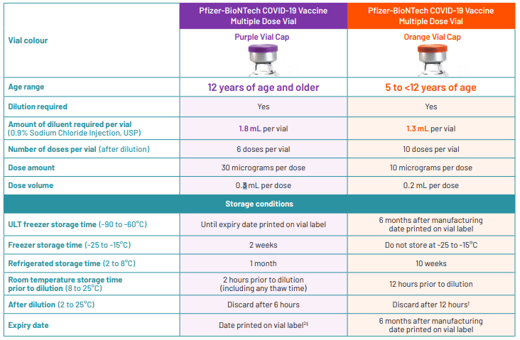
What is the difference between the adult and the pediatric formulation of the Pfizer vaccine?
Notes:
Avoid pasting slides from different sources. Instead insert as new slide / click reuse slides / click the slide you want to reuse and it will be placed into your presentation with your template styles. If the fonts do not look correct reset slide.
Starting with a health unit template to keeps the design and formatting consistent. All of the font sizes and styles are set for you so there should be no need for hard formatting.

Slide 5
Ingredients
Adult/Adolescent Formulation | Pediatric Formulation
ALC-0315 = ((4-hydroxybutyl) azanediyl)bis (hexane-6,1-diyl)bis(2-hexyldecanoate) ALC-0159 = 2-[(polyethylene glycol)-2000]- N,N-ditetradecylacetamide 1,2-distearoyl-sn-glycero-3-phosphocholine cholesterol dibasic sodium phosphate dihydrate monobasic potassium phosphate potassium chloride sodium chloride sucrose water for injection | ALC-0315 = ((4-hydroxybutyl) azanediyl)bis (hexane-6,1-diyl)bis(2-hexyldecanoate) ALC-0159 = 2-[(polyethylene glycol)-2000]- N,N-ditetradecylacetamide 1,2-distearoyl-sn-glycero-3-phosphocholine cholesterol tromethamine tromethamine hydrochloride sodium chloride sucrose water for injection

Slide 6
Tris Buffer
The only difference in ingredients between the two formulations is that the pediatric formulation uses a Tris buffer.
“Tromethamine (Tris or trometamol) is used as a buffer in vaccines and medications, including those for use in children, to improve stability and prevent pH fluctuations in the solution. No safety concerns have been identified with tromethamine.” (NACI Statement)
This increased stability is important - allows the vaccine to be stored at 2-8°C for longer periods of time (up to 10 weeks), maintains stability for up to 12 hours after dilution and can be moved in a thawed state when needed.
Tris is used in Act-HIB & Nimenrix vaccines already

Slide 7
Dosage
Children are to receive the dosage that is approved for use for their age on the day they get their vaccine
Children who are turning 5 in 2021 (2016 birth year) are eligible to receive the vaccine even if they have not yet had their 5th birthday. For 2022, provincial decision making is underway regarding eligibility of children turning 5 in 2022 (2017 birth year).
Children 5 to 11 years (or turning 5 in 2021) of age should receive the 10 mcg dose, whereas children 12 years of age and older should continue to receive the 30 mcg dose.
Children who are 11 years old and received the 30 mcg dose as their first dose under Ontario’s extended eligibility for the 2009 birth cohort are recommended to complete the series with the product authorized for their age at time of the second dose (i.e. 10 mcg is 11 years, 30 mcg if 12 years).
Children who receive the pediatric formulation of the Pfizer-BioNTech COVID-19 vaccine (10 mcg) for their first dose who turn 12 by the time of their second dose may receive the adolescent/adult formulation of the Pfizer-BioNTech COVID-19 vaccine (30 mcg) to complete their primary series.

Slide 8
Dosage continued
Why did 11-year-olds receive 30mcg until now, but now they should receive the lower dosage?
Recommendations evolve and change as new, better and/or more complete data becomes available.
We now have data available from the 5- to 11-year-old clinical trial, that kids who received the 10mcg dose generated a similar immune response (non-inferior) compared to 16- to 25-year-olds who received a 30 mcg dose. The vaccine was 91% effective in the trial, and children also experienced less side effects with the lower dose.
Now that this smaller dosage has been authorized, it would be inappropriate to give the adult dose when we know the smaller dose will provide the same protection with decreased side effects.

Slide 9
Approved vs. Recommended Dose Interval
Health Canada approved a 21-day interval however NACI is recommending at 8-week interval based on emerging evidence:
Longer interval results in a better and longer immune response
Longer interval may be associated with lower risk of myocarditis or pericarditis
While there were no cases of peri/myocarditis in the clinical trial and no safety signal in 5- to 11-year-olds to date, data from older age groups suggests an extended interval may be associated with a reduced risk of myocarditis/pericarditis following a second dose of mRNA COVID-19 vaccine.
As per the table above, nurses under this directive can administer the vaccine at a 21-day interval if the parent provides informed consent based on recommendation above.

Slide 10
Myocarditis & Pericarditis
Rare cases of myocarditis/pericarditis following COVID-19 mRNA vaccination occur most commonly in adolescents and young adults (12 to 30 years of age), more often after the second dose, more often in males than females, more often after Moderna than Pfizer-BioNTech, and usually within a week of vaccination.
Myocarditis following mRNA COVID-19 vaccination tends to have a similar epidemiologic profile to classic myocarditis (unrelated to COVID-19), as it occurs more commonly in adolescents and young adult males. Classic myocarditis is less common in younger children 5-11 years of age.
While it is unknown whether myocarditis/pericarditis will occur after the lower dose vaccine for children 5-11 years of age, close post-marketing surveillance as always will be conducted to monitor for any signals.
Emerging Canadian safety surveillance data suggest an extended interval between the first and second dose may reduce the risk of myocarditis/pericarditis associated with the second dose of an mRNA COVID-19 vaccine

Slide 11
Contraindications
Those who have had severe allergic reaction or anaphylaxis to a previous dose of COVID-19 mRNA vaccine or to any of its components (polyethylene glycol and, due to potential cross-reactivity, polysorbate) should not receive the mRNA COVID-19 vaccine in a community-based vaccine clinic. These people need an urgent referral to an allergist or immunologist to determine how/if they will complete their series.
For those who have had an allergic reaction within 4 hours and/or anaphylaxis that occurred with a vaccine or injectable medication that does not contain a component or cross-reacting component of mRNA COVID-19 vaccines, the vaccine can be given with an extended post-vaccination observation time of 30 minutes.
Those with a history of significant allergic reaction and/or anaphylaxis to any food, drug, venom, latex or other allergens not related to the mRNA COVID-19 vaccine can receive the vaccine with an extended post-vaccination observation time of 30 minutes.

Slide 12
2. Pfizer-BioNTech COVID-19 Vaccine is contraindicated in those with an allergy to any component of the vaccine or an anaphylactic or other allergic reaction to a previous dose of this vaccine:
The pediatric product does not contain latex.

Slide 13
Pfizer-BioNTech COVID-19 vaccine should only be administered in SMDHU clinics to the following groups if they have consulted with their treating physician and it has been determined that the potential benefits of vaccination outweigh the potential risks:
Those who are receiving the following immunosuppressive therapies: stem cell therapy, CAR-T therapy, chemotherapy, immune checkpoint inhibitors, monoclonal antibodies (e.g. rituximab) and other targeted agents (e.g., CD4/6 inhibitors, PARP inhibitors etc.)
As a precautionary measure, and consistent with current recommendations for adolescents and adults, the second dose in the mRNA COVID-19 vaccination series should be deferred in children who experience myocarditis or pericarditis following the first dose of the Pfizer-BioNTech COVID-19 vaccine until more information is available. Children who have a history of myocarditis unrelated to mRNA COVID-19 vaccination should consult their clinical team for individual considerations and recommendations.
For children who have been diagnosed with Multisystem Inflammatory Syndrome (MIS), vaccination is to be postponed until recovered or ≥90 days since diagnosis, whichever is longer.

Slide 14
Coadministration with other vaccines
As per NACI, children should wait 14 days between receiving COVID-19 vaccine and any other vaccine. However, this suggested minimum waiting period between vaccines is precautionary and therefore concomitant administration or a shortened interval between COVID -19 vaccines and other vaccines may be warranted in some circumstances which may include:
Where there is a risk of the individual being unable to complete an immunization series due to limited access to health services or being unlikely to return at a later date
When an individual may not return to receive a seasonal influenza vaccine
When another vaccine is required for post-exposure prophylaxis
When individuals require accelerated vaccination schedule prior to immunosuppressive therapy or transplant
At the clinical discretion of the healthcare provider
If a parent does not want to delay vaccination in these situations, understands the rationale for the recommended 14-day interval and provides informed consent nurses can administer the vaccine to children who have had another vaccine within 14 days under this directive.

Slide 15
Safety & efficacy profile
the pediatric formulation of the vaccine produces a good immune response in children 5 to 11 years of age, similar to the response seen in young adults 16 to 25 years of age who receive the adolescent/adult formulation.
preliminary efficacy of the 10 mcg dose vaccine against symptomatic COVID-19 in children 5 to 11 years of age is estimated to be 90.7%.
the vaccine was well tolerated in children 5 to 11 years of age. Local reactions were very common and mostly mild to moderate in severity. Reactions resolved after a median of 1 to 2 days.
interim clinical findings did not indicate any serious safety concerns and no cases of myocarditis and/or pericarditis related to the vaccine were reported.
the size of the clinical trial would not detect rare or very rare adverse events that may occur at a frequency less often than 1 in 1,000 people. Health Canada, PHAC and NACI will continue to monitor the safety and effectiveness of the vaccine.

Slide 16
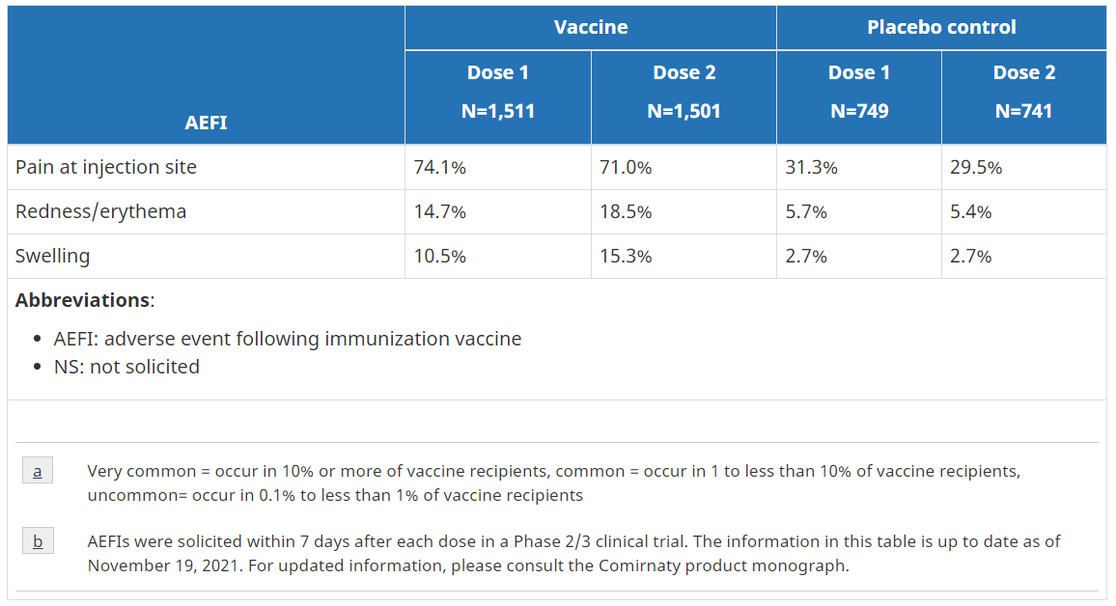
Frequency of solicited local Adverse Events in 5 to 11 year olds

Slide 17
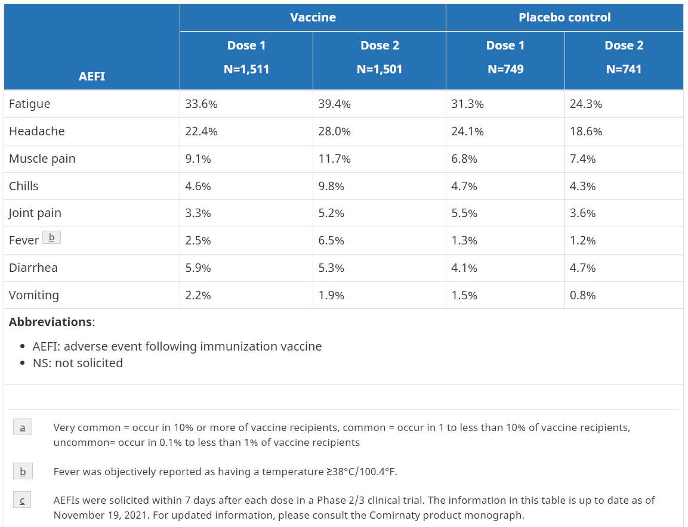
Frequency of solicited systemic Adverse Events in 5 to 11 year olds

Slide 18
Storage and handling of the vaccine
 | Adolescent/Adult Formulation | Pediatric Formulation
Storage | Ultra-frozen (-90°C to -60°C) until expiry date printed on the label Frozen (-25°C to -15°C) for up to 2 wks Refrigerated (2°C to 8°C) for up to 1 mth Room temperature for: up to 2 hours prior to dilution; up to 6 hours after dilution | Ultra-frozen (-90°C to -60°C) up to 6 mths from the date of manufacture printed on the vial and cartons Do not store frozen (-25°C to -15°C) Refrigerated (2°C to 8°C) for up to 10 wks Room temperature for: up to 12 hours prior to dilution; up to 12 hours after dilution
Transport | Ultra-frozen full cartons containing vials Refrigerated thawed vials up to 12 hours (included in 1-month limit for refrigerated storage) | Ultra-frozen full cartons containing vials Refrigerated full cartons or individual undiluted vials
Prefilled Syringes | Can be transported at 2-8°C, up to their 6 hours expiry (don’t transport diluted vials) | Can be transported at 2-8°C, up to their 12 hours expiry (don’t transport diluted vials)
Pooling of Doses | Can pool residual vaccine from up to 3 vials to make a full dose | Not permitted at this time

Slide 19
Next steps
All immunizers must complete the following before administering the pediatric COVID-19 vaccine:
Review this PowerPoint
Review the Directive in its entirety
Review the Summary of the NACI 5- to 11-year-old Statement
Review page 44 – 51 of COVID-19 Vaccine Administration
For more detailed information, immunizers can refer to the following:
Full NACI Statement
Product Monograph

