Slide 1
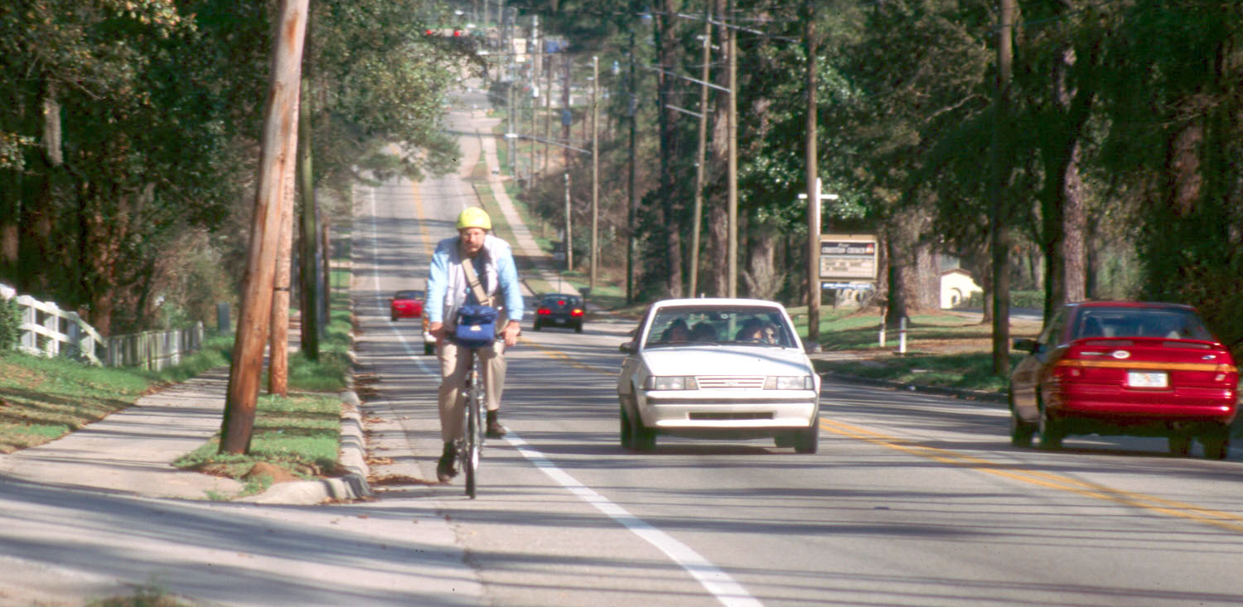
Good Roads and Beyond
Charles Gardner, MD, CCFP, MHSc, FRCPC
Medical Officer of Health
Notes:
Feb 23, 2016: http://combinedconference.org/about/
OGRA/ROMA Conference Session Outline
Public Health and Transportation: Meeting at the Intersection (working title)
Can a road be more than ‘just’ a road? What are some new ways of looking at our transportation systems? The purpose of this session is to examine the broader role that transportation and roads planning play within communities, and the opportunities that lie in creating transportation systems to accommodate multiple modes. Public health is a partner with expertise to share. Find out where and how public health and transportation goals intersect, how working with public health can add value to transportation projects/planning and hear examples of collaboration between these two sectors, including results on the ground and impacts on the community.
Objectives:
To provide a rationale for planning and designing roads for multi-modal use
To identify ways in which public health and transportation goals and outcomes intersect
To provide examples where public health and transportation have successfully collaborated around process, policy and design of multi-modal transportation networks
To identify opportunities for future collaboration
Session Outline (total 90 minutes)
Welcome and Introduction (15 min) - Sue
Introduce panel
Review agenda
What is transportation? Get audience perspectives
Thinking beyond the car; reframing transportation: a resource to the community- for people and goods to get to where they need to go – safely, conveniently, sustainably, comfortably
Evidence that the province is seeing transportation as more than just planning for cars
Rural transportation challenges
Public Health and Transportation (15 min) – “why engage with public health?” - Chuck
Public health as a partner – what we have to offer: who we are, what we do, and how we work
Why we have an interest in transportation – how do roads and transportation contribute to public health?
Safety – e.g. lowering speed limits and reduction in injury
Equity – e.g. rates of car ownership, %age of non-drivers, meeting needs of aging population
Sustainability – encouraging other modes of travel is good for environment
Prosperity – quality of life; positive economic impact of walking/cycling
How/where do public health goals intersect with transportation planning and design goals?
Case Studies: Making it work in rural communities (30 min total – 2x 15 min)
These examples give practical ideas/solutions as well as outcomes/impacts, where public health and transportation are collaborating to make communities more safe and accessible for all modes of transportation.
County Wide Active Transportation System (CWATS) – Cathy Copot-Nepzsy, Windsor Essex County Health Unit
Huron County Active Transportation Strategy – Laura Dekroon – Huron County Health Unit
Questions and Conclusions: (15 min) – ALL - Sue to moderate
So What Next? Our research findings: (15 min) – Sue to moderate
briefly review a summary of key findings from the Built Environment Workgroup’s key informant interviews re: collaboration between public health and transportation professionals. Ask for further thoughts on what efforts or actions could build understanding and future work between the two.

Slide 2
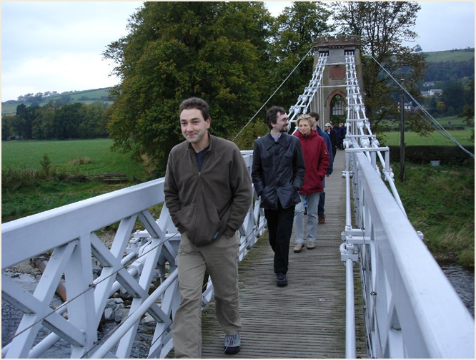
Public Health:
Working on the Things that Make Us Healthy
Environment
  physical, social, political, economic
Behaviour
  smoking, diet, physical activity, injuries, sexual health
Human Biology
  age, gender, family history
Health Care
  prevention, treatment, rehabilitation

Slide 3
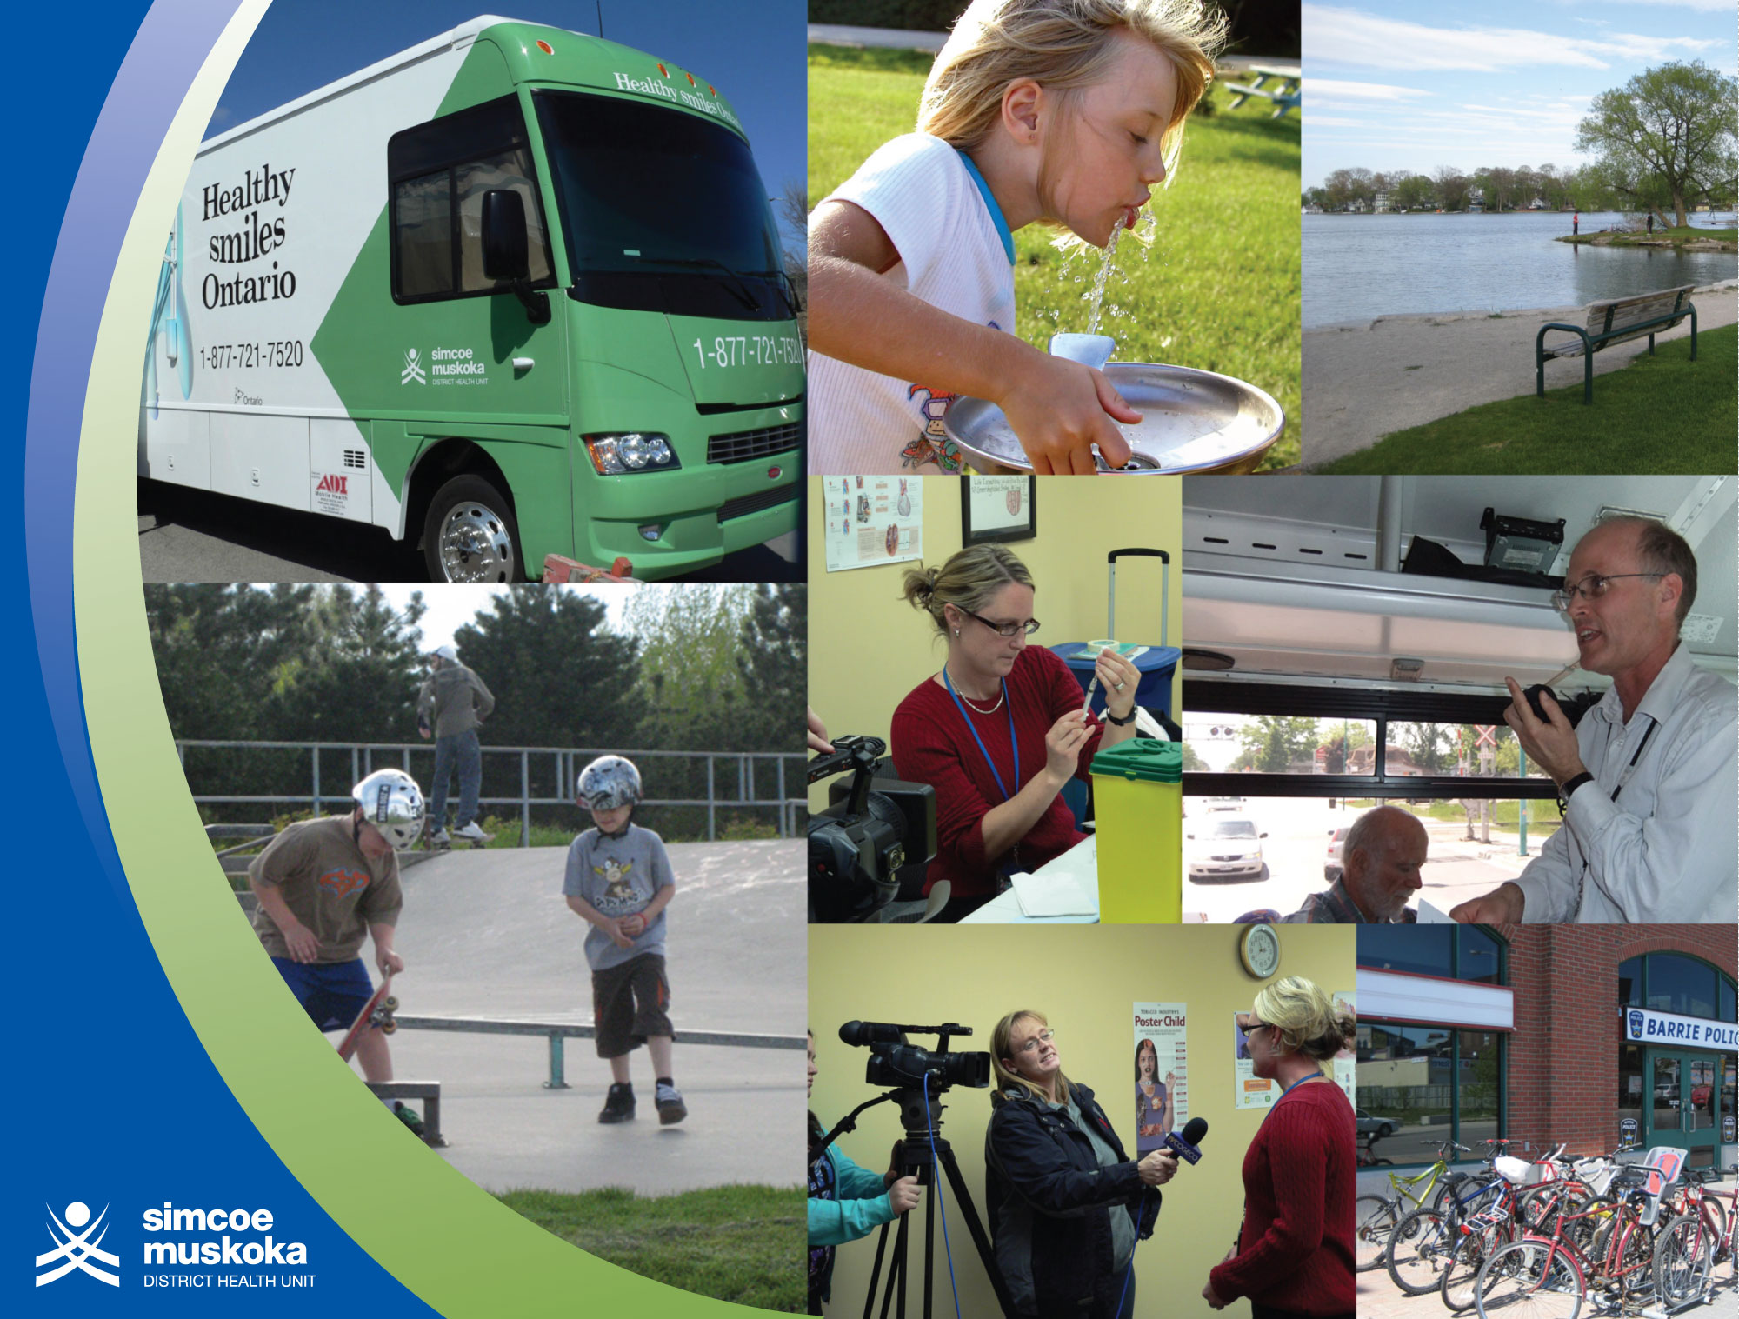

Slide 4
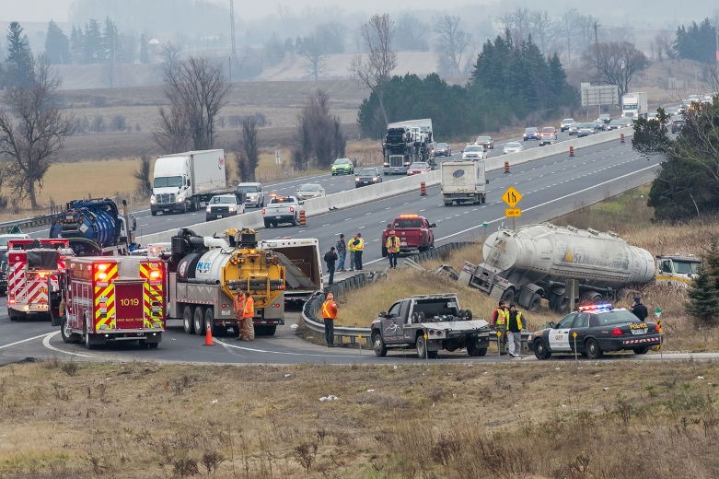
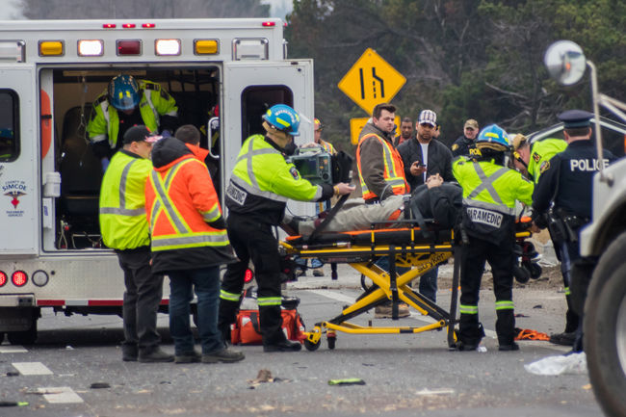
Making the News
  On Friday, December 11, 2015 the Barrie Examiner reported…
    A 63 year old woman died after being struck while walking to work off the side of a busy road in Barrie.
    A 20 year old man will return to court regarding a crash that killed a 20 year old woman on Warminster Sideroad
    A crash between two trucks closed Highway 400 south of Highway 88 for several hours – minor injuries to both drivers
    A driver near Bradford was arrested for impaired driving.

Slide 5
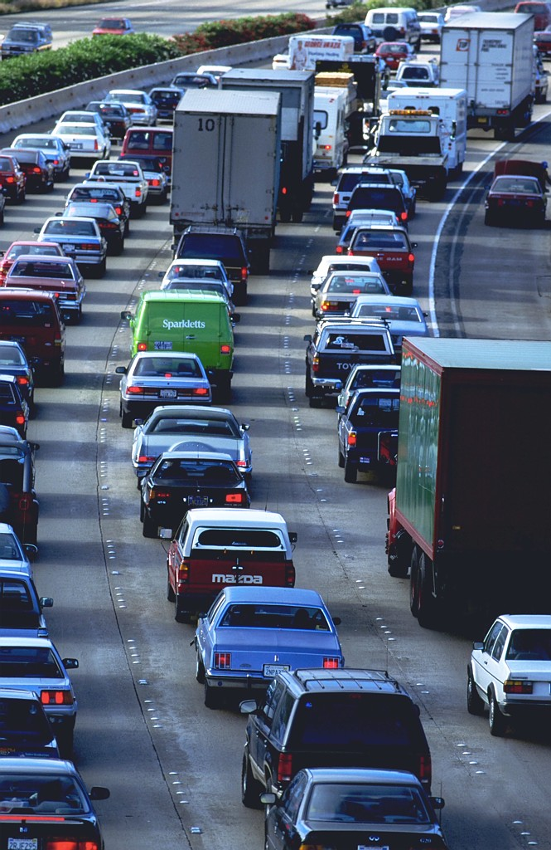
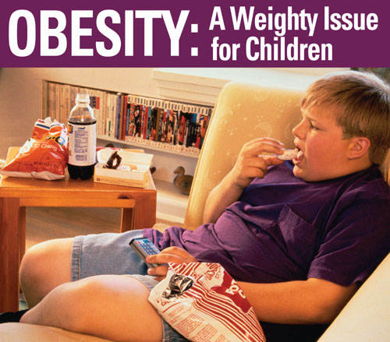
Transportation is a Public Health Issue
Many of our health challenges are related to how we have built our communities, including our transportation systems.
Notes:
http://report.mitigation2014.org/spm/ipcc_wg3_ar5_summary-for-policymakers_approved.pdf
Summary for Policymakers IPCC WGIII AR5
The next two decades present a window of opportunity for mitigation in urban areas, as a large
portion of the world’s urban areas will be developed during this period (limited evidence, high
agreement). Accounting for trends in declining population densities, and continued economic and
population growth, urban land cover is projected to expand by 56–310% between 2000 and 2030.
[12.2, 12.3, 12.4, 12.8]
Mitigation options in urban areas vary by urbanization trajectories and are expected to be most
effective when policy instruments are bundled (robust evidence, high agreement). Infrastructure
and urban form are strongly interlinked, and lock‐in patterns of land use, transport choice, housing,
and behaviour. Effective mitigation strategies involve packages of mutually reinforcing policies,
including co‐locating high residential with high employment densities, achieving high diversity and
integration of land uses, increasing accessibility and investing in public transport and other demand
management measures. [8.4, 12.3, 12.4, 12.5, 12.6]
SPM.5.1 Sectoral and national policies
Substantial reductions in emissions would require large changes in investment patterns. Mitigation
scenarios in which policies stabilize atmospheric concentrations (without overshoot) in the range
from 430 to 530 ppm CO2eq by 2100 lead to substantial shifts in annual investment flows during the
period 2010–2029 compared to baseline scenarios (Figure SPM.9).
In addition, annual
incremental energy efficiency investments in transport, buildings and industry is projected to
increase by about USD 336 (1–641) billion (limited evidence, medium agreement), frequently
involving modernization of existing equipment. [13.11, 16.2.2]

Slide 6
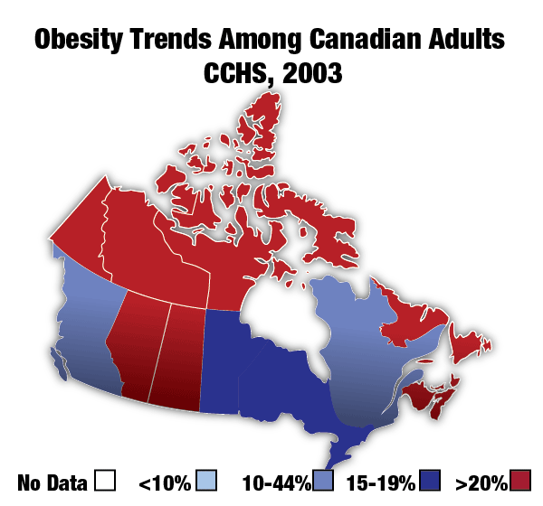
A Dramatic Increase in Obesity
Notes:
Source: Statistics Canada, health indicators May 2002

Slide 7
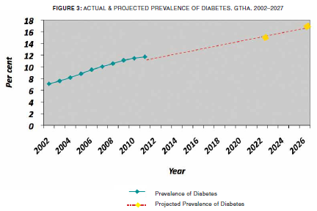
Increasing Diabetes
Notes:
Sources: Ontario Diabetes Database (2011). Institute for Clinical and Evaluative Sciences (ICES), Toronto, Ontario, 2013.
Rosalla, L C et al, 2010. A population based risk algorithm for the development of diabetes: Development and validation of the diabetes population risk tool (DPoRT). J Epidemiol Community Health, doi:10.1136/jech.2009.102244

Slide 8
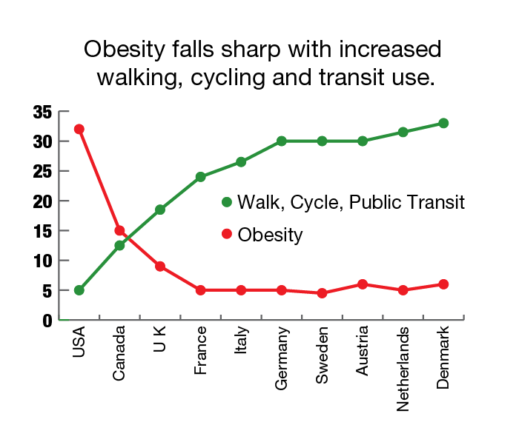
Auto-dependency and obesity?
Notes:
Chronic Disease Prevention Alliance of Canada
Source: Pucher and Dijkstra, “Promoting Safe Walking and Cycling to Improve Public Health, Am Journal of Public Health, September 2003

Slide 9
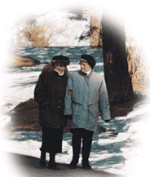
Physical activity reduces…
  Heart disease
  Falls and injuries
  Obesity
  High blood pressure
  Adult-onset diabetes
  Osteoporosis
  Stroke
  Depression
  Colon cancer
  Premature death

Slide 10
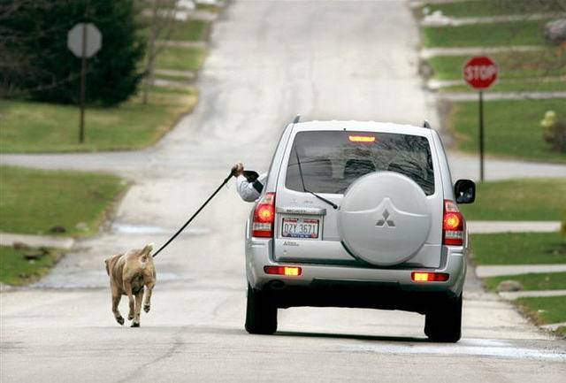
…yet we have engineered physical activity out of our lives.
Notes:
News article from http://news.asiantown.net/r/13445/lazy-man-fined-for-using-car-to-walk-dog

Slide 11
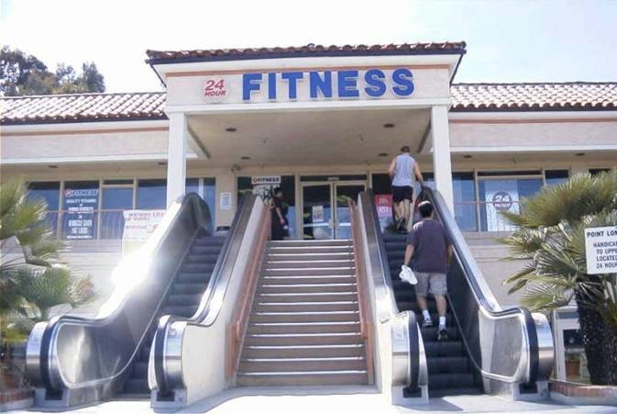
Recreation alone is not the answer
Notes:
Random web image, not verified as Creative Commons but was most recently used from this blog site: recently posted at How2GetFat.com. Considering the nature of the image and your use of it we can be confident that the doctrine of fair use would apply to the situation.

Slide 12
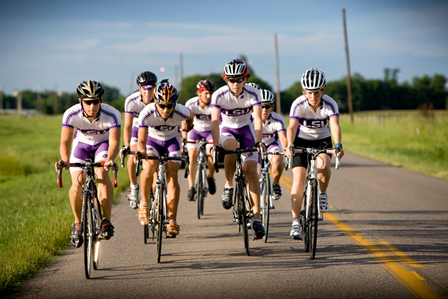
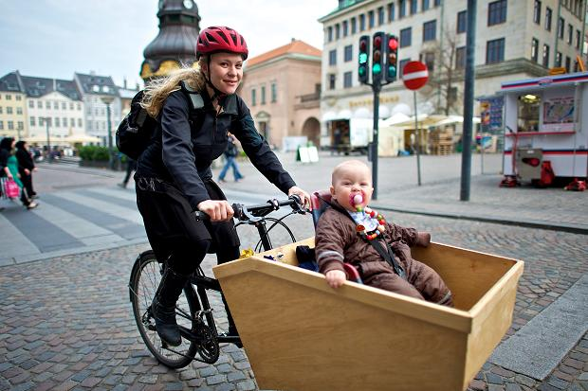
Recreation alone is not the answer

Slide 13
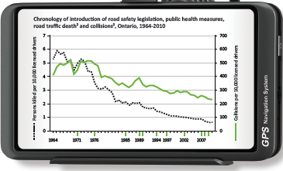
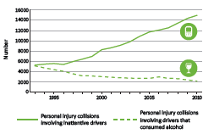
Road Safety
In Ontario in 2012, there were 568 deaths related to road travel:
  68% were car occupants
  1/5th were pedestrians / cyclists
There are over 100 injuries for every death
Notes:
Ontario Trauma Registry 2009 reported that RTCs accounted for 35% of in-hospital deaths for 2008 to 2009, and of these injuries and deaths, almost 30% were pedestrians.¹⁰
10. Office of the Chief Coroner for Ontario. Pedestrian Death Review. A Review of all Accidental Pedestrian Deaths in Ontario from January 1st, 2010 to December 31st 2010. Accessed May 24, 2015. Available from http://www.mcscs.jus.gov.on.ca/english/DeathInvestigations/office_coroner/PublicationsandReports/PedestrianDeathReview/DI_Pedestrian_Death_Review.html.
Canada’s 2010 Road Safety Strategy set a national target of a 30% decrease in the average number of road users killed and seriously injured during the 2008-2010 period over comparable 1996-2001 baseline numbers, addressing the specific areas of occupant restraints, impaired driving, commercial vehicle safety, vulnerable road users, speed, intersection safety, rural roads, young drivers and high-risk drivers.¹¹ This goal was largely achieved. The largest reductions in fatalities occurred on rural roads, followed by crashes involving unrestrained occupants and those involved in intersection crashes.⁷ Notable progress was achieved for seriously injured unrestrained motor vehicle occupants, those involved in rural road crashes and young drivers. However, the number of fatally and seriously injured vulnerable road users and drinking drivers experienced the least progress among this national target.⁷
7. International Transport Forum. International Traffic Safety Data and Analysis Group. Road Safety Annual Report 2013. Accessed May 24, 2015. Available from http://www.internationaltransportforum.org/Irtadpublic/index.html.
11. Canadian Council of Motor Transport Administrators. Canada’s Road Safety Strategy 2015. Accessed on May 25, 2015 from http://ccmta.ca/crss-2015/.
Between 2009 and 2013, fatalities by road user class in Canada was as follows: 50.1% drivers 18.1%, passengers, 15.6% pedestrians, 10.3% motorcyclists, 3.2% bicyclists and others 2.7%.³ In 2013, the reported fatality rate in Canada was 6 per 100,000 licensed drivers and 3.5 per 100,000 population, with an injury rate of 622.1 per 100,000 licensed drivers.³
3. Canadian Motor Vehicle Traffic Collision Statistics: 2013. Accessed on May 24, 2015 from http://www.tc.gc.ca/media/documents/roadsafety/cmvtcs2013_eng.pdf.

Slide 14
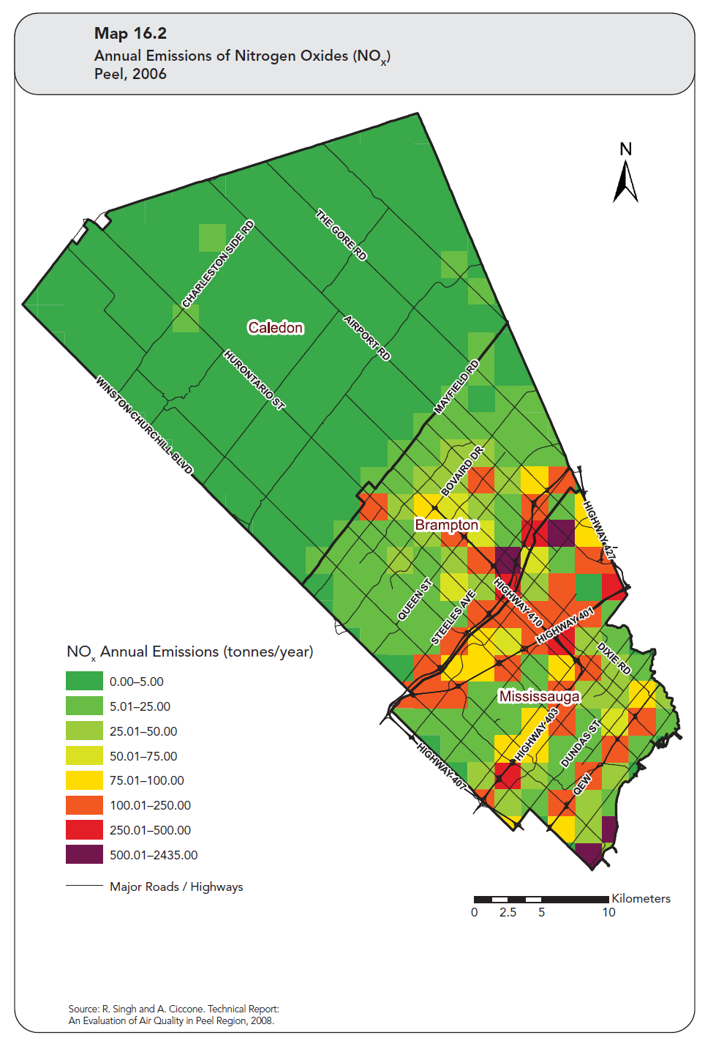
Air Quality Impacts Near Traffic
Notes:
Localized air quality impacts follow the density of cars – a Peel report
Page 169, Map 16.2
Annual Emissions of Nitrogen Oxides (NOX)
Peel, 2006
The Physical Environment http://www.peelregion.ca/health/health-status-report/chsr/chapter16.htm#chap16
Built Environment Data: Locally Driven Collaborative Project:
KINGSTON, FRONTENAC AND LENNOX & ADDINGTON PUBLIC HEALTH (PROJECT LEAD) NIAGARA REGION PUBLIC HEALTH PUBLIC HEALTH AGENCY OF CANADA SUDBURY & DISTRICT HEALTH UNIT YORK REGION PUBLIC HEALTH
Traffic emissions are the principal source of variation in the levels of air pollutants within many • cities; Traffic emissions have an impact on air quality at an urban and regional scale as well as a local • scale; and Air pollution associated with traffic corridors can extend up to 300 to 500 metres from a highway • depending upon factors such as traffic volume, wind direction and wind speed.
Public Health and Land Use Planning: Highlights
Clean Air Partnership (includes OPHA) - 2011
The lowest income populations in Toronto and Montreal were 3.5 and 2.8 times, respectively, more likely to live within 200 metres of a highway than the highest income populations; and
• Twenty-five per cent of people from the lowest income populations in Canada's urban regions live within one kilometre of a pollution-emitting facility while only seven per cent of people from the highest income populations do (CIHI, 2011a).

Slide 15
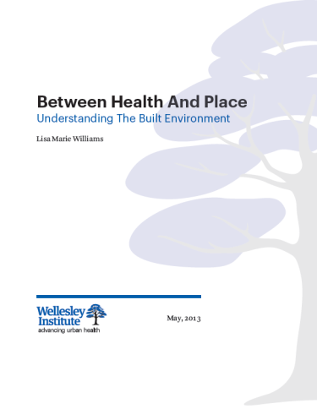
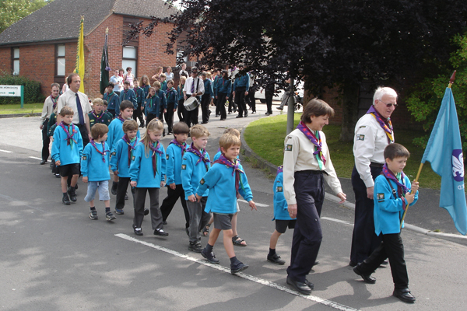
Many cannot drive…
Youth, many seniors, people of low income or with disabilities have a greater need for public transit, active transportation and complete communities
Everyone needs access to employment, social activities, recreation, contribute to the community
Rural populations have more health challenges
Notes:
http://www.heartandstroke.com/site/apps/nlnet/content2.aspx?c=ikIQLcMWJtE&b=4955951&ct=4512815 re rural health challenges
equity aspects of transportation like the need to provide options for people on low income, seniors, people with disabilities, youth etc in order for them to connect to employment, social activities, recreation, contribute to the community
[1] Putman R. (2000, as cited in Frumkin et al, “Urban Sprawl and Public Health: Designing, Planning, and
Building for Healthy Communities”, 2004)
In Canada, the average driver spent 12 full days (or 275 hours) commuting to work in 2005 (Statistics Canada). 443 hours per year driving in USA – 3 to 4 times more in sprawl versus well planned communities
“each additional ten minutes spent in daily commuting time cuts involvement in community affairs by 10 percent”.
Road rage – a 2003 survey revealed that 84% of Canadians admitted to engaging in at least one act of aggressive driving.
Fear
Loss of community sense
Green space and biophilia

Slide 16
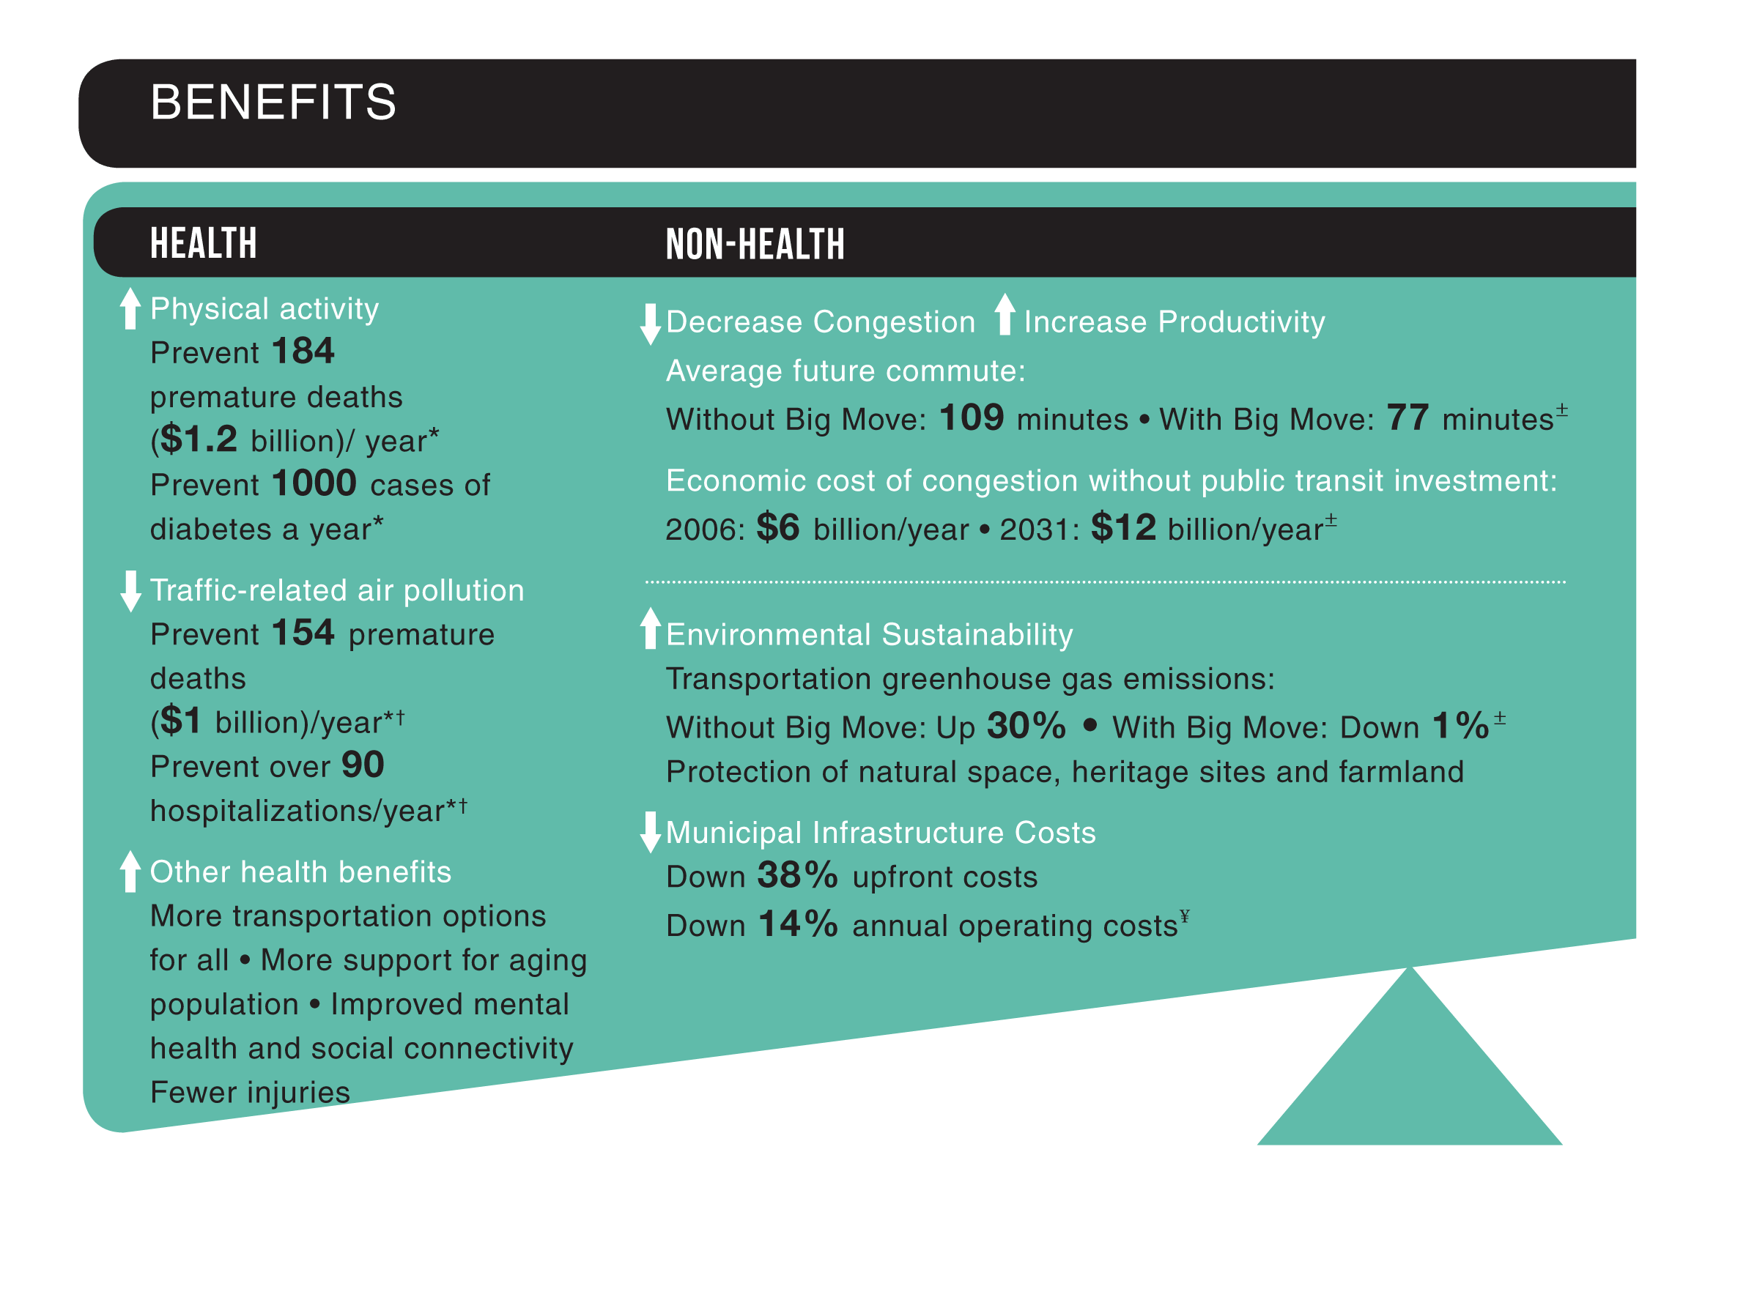
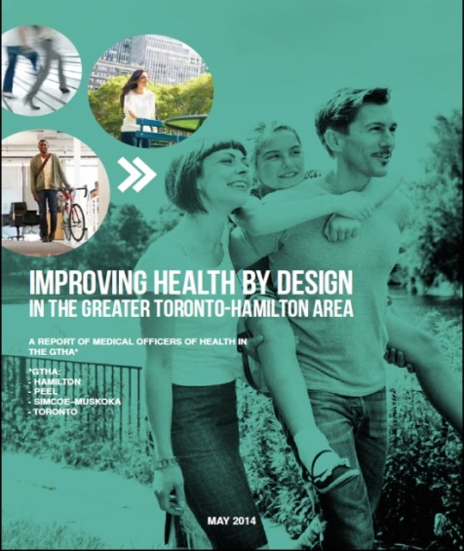

The Many Benefits of Regional Public Transit
Notes:
Over 300 deaths and 1000 new cases of diabetes per year would be prevented, with very modest changes in behaviour, and with substantial co-benefits (environmental, congestion, municipal costs)
Metrolinx $2 billion annually, $50 billion total investment

Slide 17

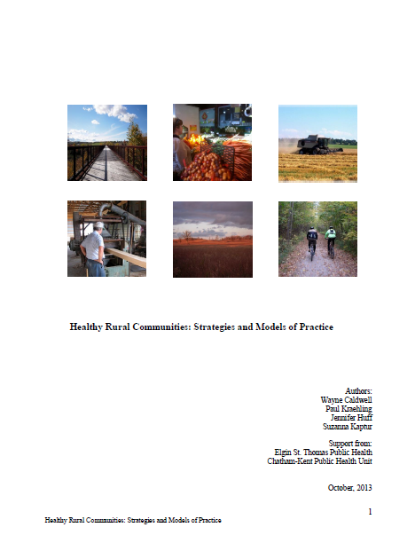
Healthy Rural Travel
Safety
  Reduced driving – density, complete communities
  Reduced speed, road design (including for walking /
  cycling), enforcement
Improving air quality
  Land intensification, and design for active and public transportation (including school locations)
  Housing separated from traffic corridors / industry
Multi-modal transportation – public and active
  Distributed activity destinations (reduced distances)
  Grid and connectivity (including to trails)
  for new streets
  Mass transit (enabled with density)
  Late night school buses and car pooling
Notes:
Listed below are some initial changes which may improve opportunities for active transportation in rural communities, thereby achieving the health benefits associated with physical activity:
• Activity destinations and facilities, whether they be a naturalized trail system, dedicated bike paths/lanes, children’s park or a formal recreational facility (i.e. soccer fields/swimming pool, etc.) should be adequately distributed throughout a community making access to such facilities as equitable as possible.
• Innovative ideas such as late night school buses and organized car pools that can transport youth to recreational amenities within their communities.
• Where population density warrants, development of mass public transit should be a priority.
• New streets should have good connectivity with the existing street pattern, based on a grid pattern. As well, streets should have clear connections to trail systems within a community.

Slide 18

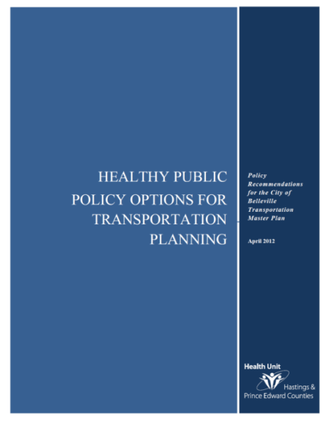

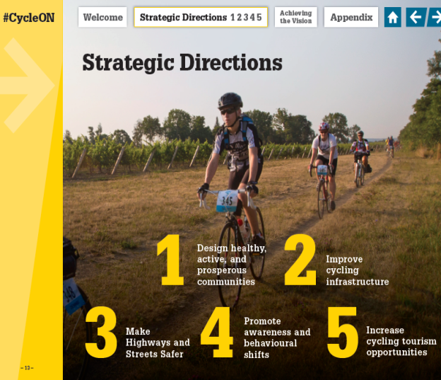
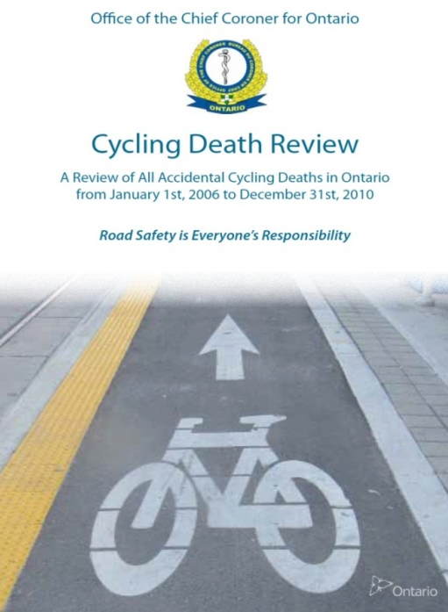
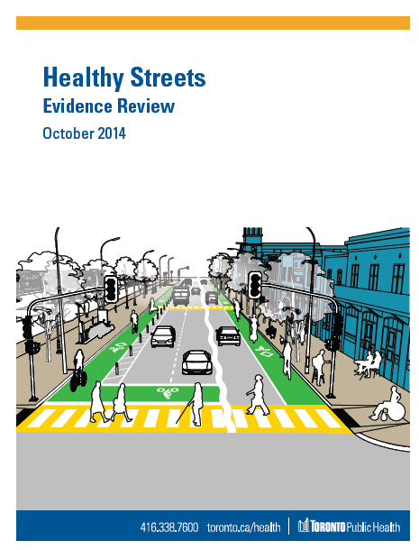
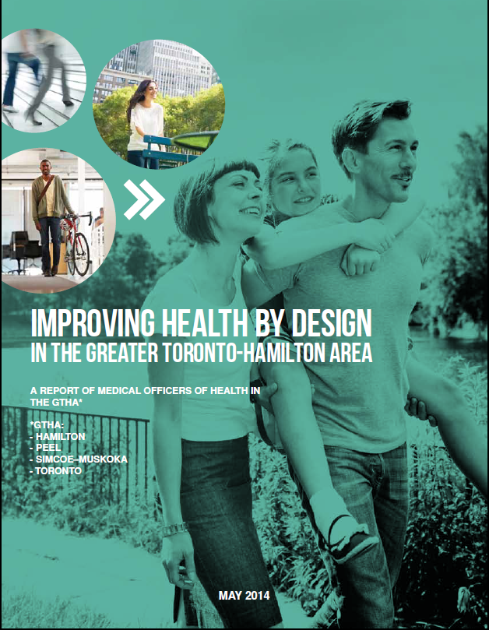
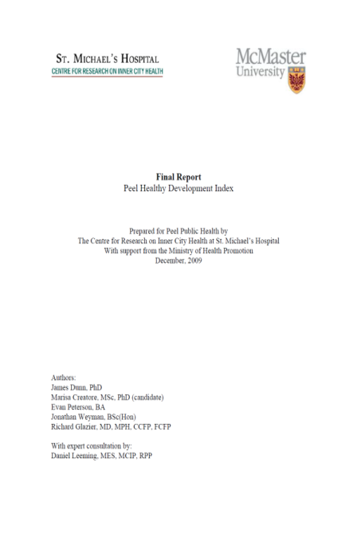

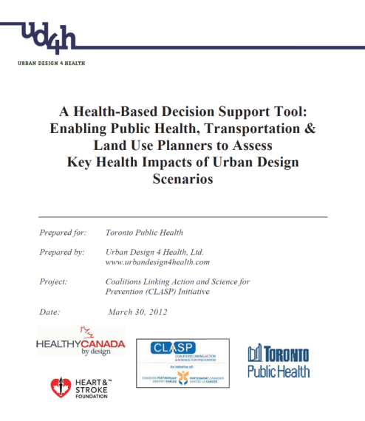

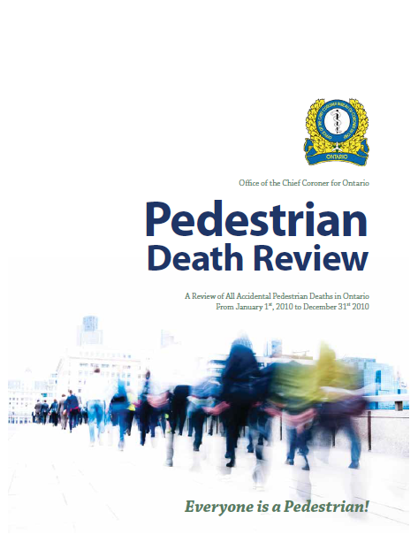
Public Health SUPPORTS
HEALTHY Transportation …

Slide 19
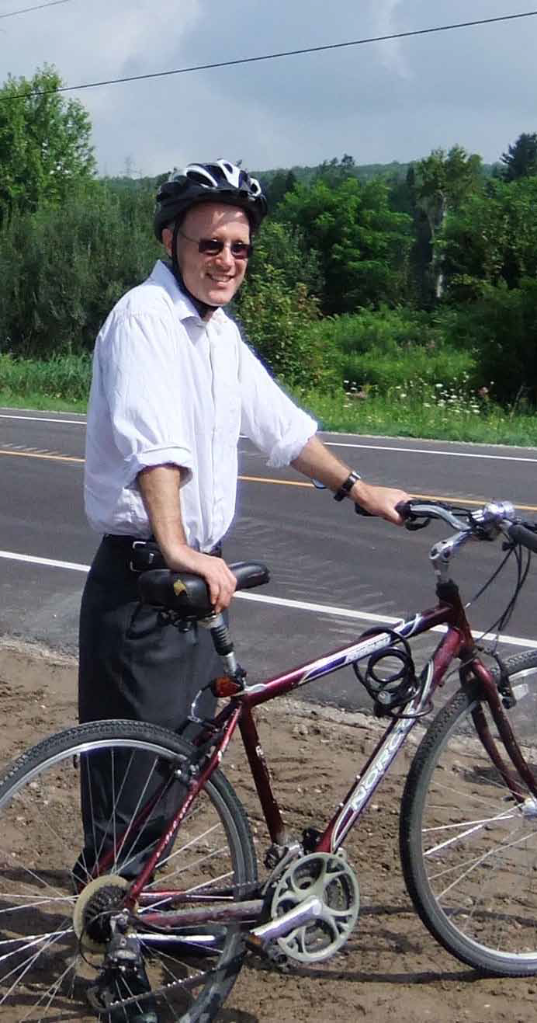
Final Thoughts
Our travel impacts on our health in many ways.
Safe options beyond private vehicle use, as well as driving safety are needed for healthy rural transportation.
Local Public Health agencies are partners in achieving healthy transportation.

