Slide 1
Childhood obesity prevention
Lisa Simon, MD MPH CCFP FRCPC
Associate Medical Officer of Health
FMTU, May 4, 2016

Slide 2
outline
Epidemiology
Causes
Prevention

Slide 3
epidemiology
Childhood Obesity

Slide 4
WHO definitions
(CTFPHC, 2015)

Slide 5
morbidity
Childhood obesity is associated with:
In childhood and adolescence:
Type 2 DM
Hypertension
Dyslipidemia
Early puberty
Musculoskeletal disorders and sleep apnea
Reduced social and psychological functioning
In adulthood:
Adult obesity and its related consequences
CVD
Diabetes
Hypertension
Dyslipidemia
(Circulation, 2012; CMAJ, 2015)

Slide 6
Local prevalence – youth BMI

Slide 7
Prevalence by gender

Slide 8
Prevalence by income

Slide 9
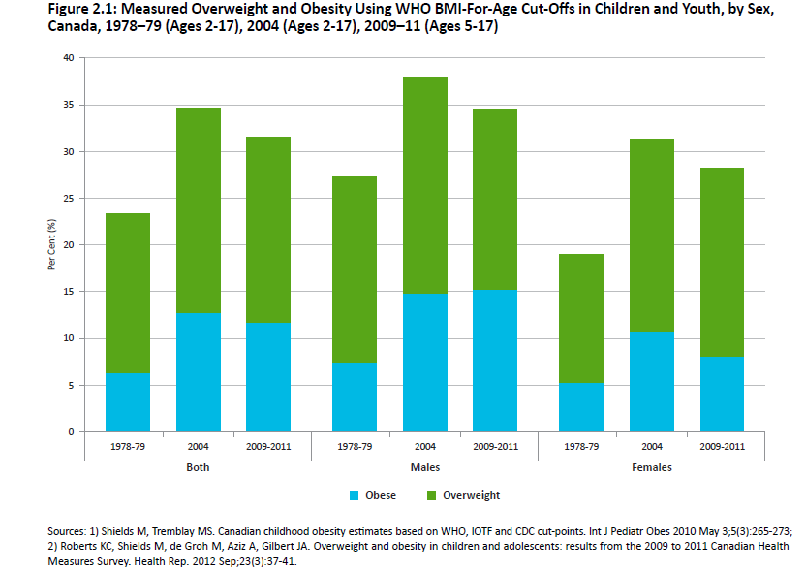
Canadian prevalence
(Public Health Ontario, 2013)

Slide 10
Canadian prevalence by age group
(Public Health Ontario, 2013)

Slide 11
causes
Childhood Obesity

Slide 12
(Public Health Ontario, 2013)

Slide 13
(Public Health Ontario, 2013)

Slide 14
Prevention
Childhood Obesity

Slide 15
Recommendations for growth monitoring, and prevention and management of overweight and obesity in children and youth in primary care Canadian Task Force on Preventive Health Care, CMAJ, April 2015
Growth Monitoring:
For children and youth 17 years and younger, we recommend growth monitoring at all appropriate primary care visits using the WHO Growth Charts for Canada (www.whogrowthcharts.ca). (Strong recommendation; very low-quality evidence)
Prevention of overweight and obesity in healthy-weight children:
We recommend that primary care practitioners not routinely offer structured interventions aimed at preventing overweight and obesity in healthy-weight children and youth aged 17 years and younger. (Weak recommendation; very low-quality evidence)

Slide 16
www.smdhu.org/PCPortal or
www.whogrowthcharts.ca

Slide 17
January, 2016
http://effectivepractice.org/resources/preventing-childhood-obesity/

Slide 18
Physical Inactivity in Canada
Age Group | Recommendation¹ | Per Cent (%) meeting Recommendation²
Adults (Ages 18 – 64) | 150 minutes moderate to vigorous/week | 15 %
Youth (Ages 12 – 17) | 60 minutes moderate to vigorous/day | 35 %
Children (Ages 5 – 11) | 60 minutes moderate to vigorous/day | 6 %
¹Canadian Society for Exercise Physiology, Canadian Physical Activity Guidelines, 2011.
²Tremblay MS, Shields M, Laviolette M, Craig CL, Janssen I, Gorber SC. Fitness of Canadian children and youth: Results from the 2007-2009 Canadian Health Measures Survey. Health Reports, 2010;21(1):7-20.

Slide 19
Nutristep
Nutritional risk screening tool
Preschool (ages 3-5) and toddler (ages 18-35 months) versions
17 questions to be completed by parents
MOHLTC-led promotion by public health units
Being gradually implemented in Simcoe & Muskoka in FHTs and CHCs, and community settings

Slide 20
Addressing other causes of Child obesity
Breastfeeding
Discussing & supporting in pregnancy, post-partum, and to 2 yrs & beyond
High birthweight
Modifiable: gestational weight gain
Maternal smoking
Priority for cessation
www.smdhu.org/PCPortal

Slide 21
Weight bias
Harm is generated through the perpetuation of weight bias, stigma, bullying and discrimination
Weight bias creates adverse outcomes for emotional functioning, personal relationships, educational attainment, employment, and healthcare.
People-first language is recommended: patient with obesity

Slide 22
Public health framework for Prevention
(Public Health Ontario, 2013)

Slide 23
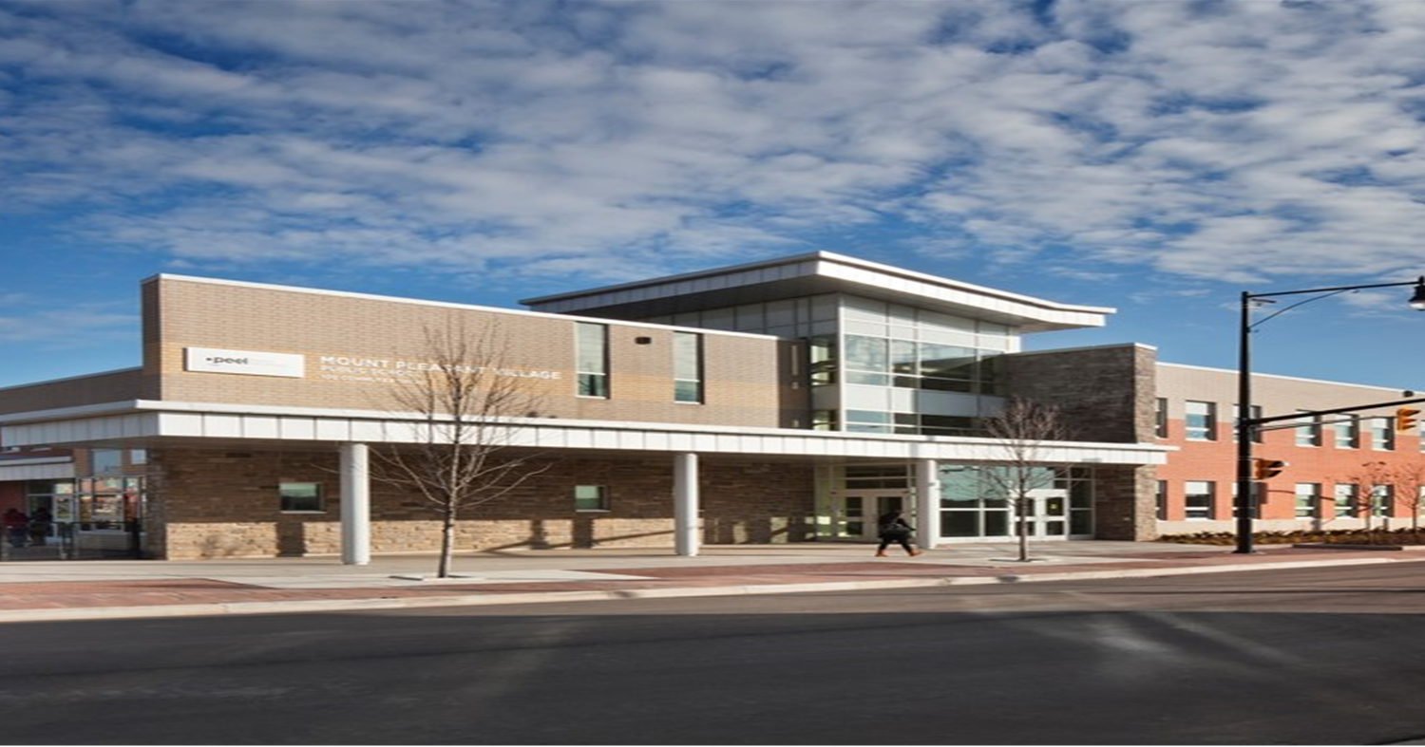
Effective public health interventions
Strongest evidence for school-based interventions for children & youth < 19 yrs, and also some for home & community-based interventions for kids < 5 yrs
(Public Health Ontario, 2013)

Slide 24
Effective public health interventions
Key features:
Targeted physical activity & healthy eating
Involved parents, culturally sensitive
Participatory activities, behaviour techniques (self-monitoring), coping skills
Increased sessions of physical activity throughout the school week
Modified the food environment of schools to improve nutritional quality
Combined education with modifications to the school environment
Were universal (e.g., did not select kids based on weight or risk factors)
Were longer in duration
(Public Health Ontario, 2013; SMDHU, 2013)

Slide 25
Healthy kids strategy

Slide 26
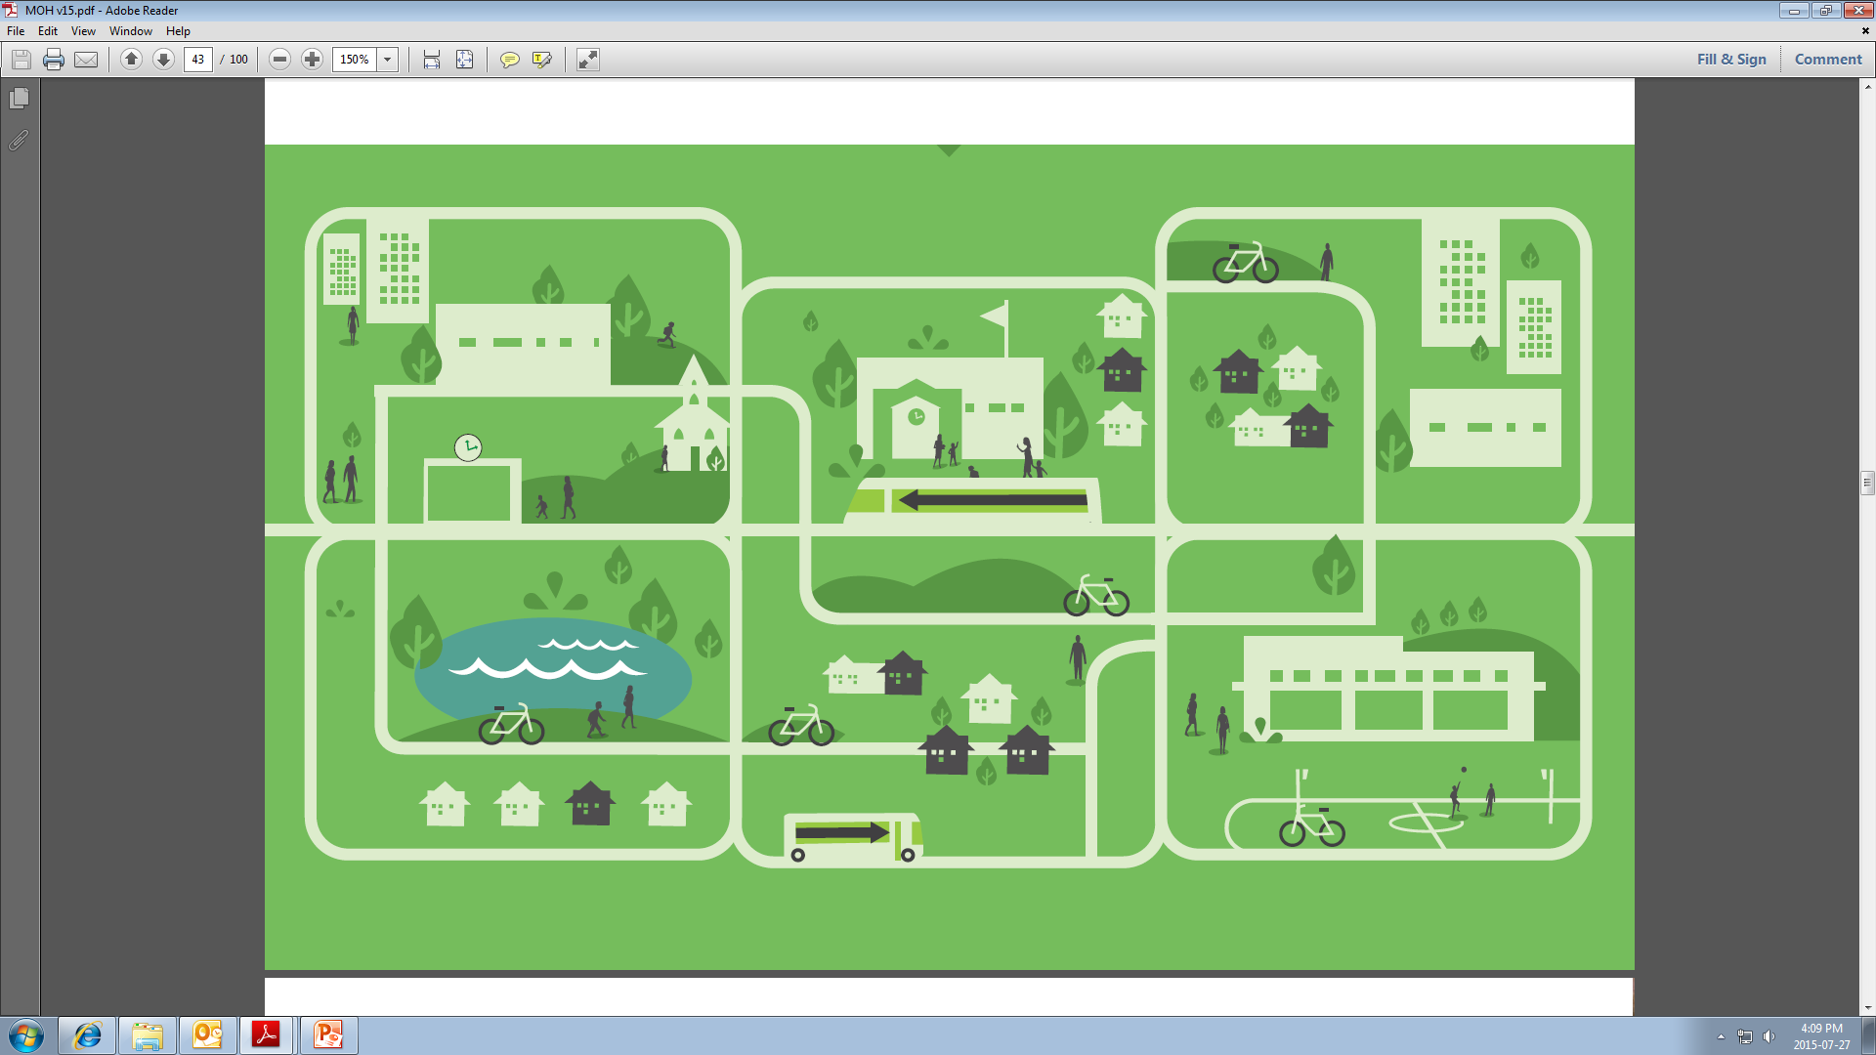
The Built Environment
Anything in our physical environment that is human-created, including:
Land-Use Patterns
Transportation Systems
Urban Design Characteristics

Slide 27
We have engineered physical activity out of our lives.

Slide 28
smdhu guidelines

Slide 29
Food policy and The food industry

Slide 30
How would you incorporate childhood obesity prevention into clinical practice?
Consistent with opportunities/tools for routine preventive care – expand from there:
Preconception health
Prenatal care
Well baby and child & adolescent immunization visits – Rourke, Greig
Address specific risk factors as arise for patients

Slide 31
Take home messages
Complex causal web for childhood obesity requires solutions at multiple levels and life stages
Key roles for primary care: monitor growth, support healthy lifestyles, recognize broader context shaping lifestyles
Emphasize lifestyle factors (nutrition, physical activity, sleep, etc) and good health, more than weight itself

