Slide 1
The SMDHU experience using Program Budgeting and Marginal Analysis
June 12, 2017
Dr. Charles Gardner

Slide 2
Faculty/Presenter Disclosure
Faculty: Dr. Charles Gardner
Relationships with commercial interests:
Not Applicable
Potential for conflict(s) of interest:
No Commercial Support

Slide 3
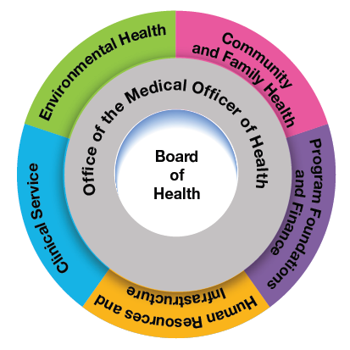
Context: The need to Rationalize in 2016
The 2015 grant freeze impacts in SMDHU:
The loss of over 11 FTEs in staffing positions, including three management positions
The reorganization of the agency with a reduction of one department
The closure of a sexual health clinic
Slimmed agency strategic plan
$90,000 in operational savings achieved
Anticipating multi-year grant freezes

Slide 4
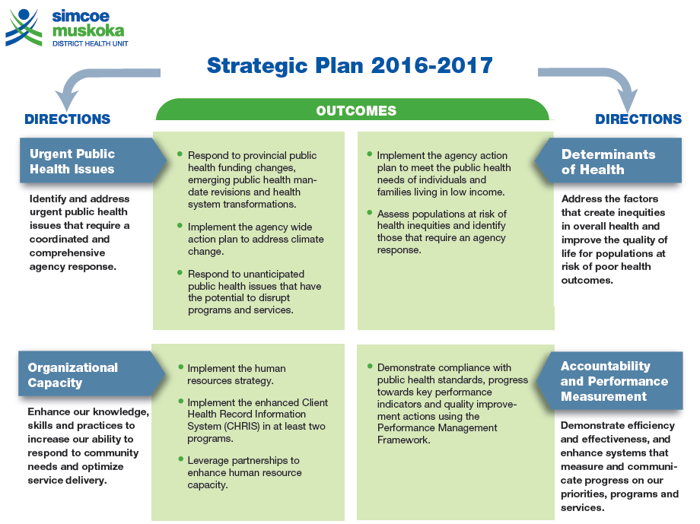
Why PBMA?
Groundwork by 3 successive PHPM residents (over 18 months)
Review of academic paper on PBMA in fall of 2015
Literature and field experience review in spring of 2016 – interviews with 4 HUs
Operational model in fall of 2016
SMDHU experience evaluation winter 2017
Opportunity for “disinvestments”
Did not pursue “Investments” for 2017
Improved resource alignment with strategic priorities
Used at various Regional Health Authorities and Public Health Units across Canada
LGL, MLHU, KFL&A, Ottawa
Fosters multi-level engagement → sense of ownership of decisions
Board and senior management
Managers developed proposals (information from their staff)

Slide 5
Approach and intentions
Tool for effective resource management
To generate proposals for disinvestment of up to 3% of the annual budget in 2017
Based on assumed 2% loss with provincial grant freeze
Allowing additional 1% for differential PBMA impacts between departments
Provide recommendations for disinvestment, thereby informing annual budget, operational and work plans
Identify best options for resource reductions while continuing to meet our public health mandate
Provide the Board with tangible information on the impacts of different funding decision options re the 2017 budget
Shortened timeline to accommodate this
Will be part of ongoing and annual planning cycle

Slide 6
Developing a leadership model
Summer of 2016
Senior management developed the model
Board of Health approval
Project Manager, and Assistant PM recruited (from among management, and PHPM resident respectively)
Job descriptions developed
Supervised by MOH
Agency staff communication strategy and HR functions
Need, intentions, approach, timelines, outcome
Development of layoff / bumping protocols (union and non-union)
Continuation of the communications from the 2015 downsizing response

Slide 7
Integrated Planning Process
Initial Communication
Staff informed re: PBMA
Site Visit
Criteria development
Board Review
Criteria review
Proposals
Exec and Board Review
Exec Committee assesses, ranks, and reviews proposals
Outputs
Managers draft proposals for disinvestment
2017 Budget
Strategic Plan
2017 Op Plan
Communications plan
Presentation to managers and staff
Proposal implementations assessed
Directors vet proposals for presentation to Exec Committee
October 2016
March 2017
PBMA Implementation Timeline

Slide 8
Review Scope
Disinvestments only in 2017
Included | Excluded
All departments (incl. MOH office) All program components involving cost-shared funds Staffing related costs (salary, benefits) for all staff Operating costs | - Program components that are 100% provincially funded

Slide 9
2017 SMDHU criteria
Criteria | Weighting
Health Impact | 16
Legislative Requirement | 16
Urgent Public Health Issues | 12
Efficiency | 10
Organizational Capacity | 10
Client Experience | 7.5
Determinants of Health | 9
Workplace Environment | 5
Collaboration/Partnerships | 7.5
Innovation/Knowledge Management | 4
Implementation Challenges | 4

Slide 10
Risk Assessment
alPHa Risk Management Tool
Used in the marginal analysis, in addition to the criteria scores
Also considered (but did not select) the following:
MOHLTC BOH Risk Tool – piloted at SMDHU in 2013
MCSS/MCYS Agency Risk Assessment Reporting Tool

Slide 11
Proposal review - Ground rules
2 full day meetings of senior management (“Executive Committee”) reviewed / scored the proposals: implementation plan, financial tab, impact and risks
Consensus rule – “can anyone not live with this change/rating?”
Proposal discussion focused on criteria
Limited time – needed to be efficient
Made use of the parking lot for questions
Parking lot items and proposals with questions was re-addressed in subsequent meeting
First few rated proposals were reviewed and revised at the end to ensure consistency

Slide 12
Overall results
Total Value of submissions $650,000
Range $5,200 to $56,000
37 proposals submitted for review
From all departments, including MOH office
Ratings ranged from +71 to -135.5 (out of possible range from +300 to -300)
Majority had FTE implications
Selection cutoff of proposals at $450,000
Implementation challenges concentrated in the proposals scoring out of the cutoff
Health promotion programming was not disproportionately impacted
Percent of total disinvestments varied by department, beyond proportion of agency budget
Department 1: 26% of cost-shared budget but only 12% of all disinvestments selected
Department 2: 20% of cost shared budget, 26% of all disinvestments selected

Slide 13
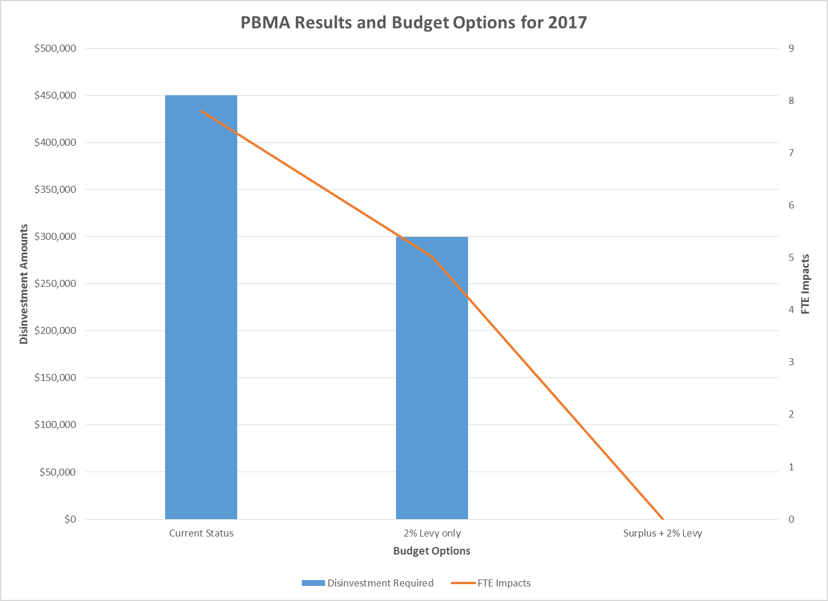

Slide 14
Decisions
Board chose to increase levy by 2% and draw on surplus
No longer 25 / 75 municipal / provincial funding balance: 27 / 73 in 2016
4 Proposals to action identified through PBMA process
Net efficiency gains
Rated scores: -16 to +71

Slide 15
Post implementation evaluation findings
Communications key - geared to specific audiences including Board of Health, Directors, Managers and staff
Need for strong project management
Many HR considerations / preparations to be managed
Be prepared for possible amendments to timelines and the need for flexibility

Slide 16
Future directions
UPCOMING YEAR
Assume ongoing provincial grant freeze
Need to consider the application of the new public health standards / Patients First within the PBMA process
Investment proposals
Include 100% provincially funded programs

Slide 17
Final thoughts
PBMA is a method for making rationale decisions re scarce resources
Method employed by SMDHU with success, going into our 2nd year

