Slide 1


Basic Income Guarantee:
A DETERMINANTS OF HEALTH PERSPECTIVE
Dr. Lisa Simon, Associate Medical Officer of Health, Simcoe Muskoka
St. Catharines, January 13, 2016

Slide 2
A brief look at
Poverty and its health impacts
Potential role of a basic income guarantee (BIG)
BIG momentum

Slide 3
Poverty and its impacts

Slide 4
Poverty as a determinant of health
“
”
The overwhelming
weight of evidence demonstrates the powerful effects of socioeconomic
and related social factors
on health.
Braveman and Gottleib, Public Health Reports, 2014

Slide 5
and a determinant of…
Educational attainment
Employment security
Children’s future income
Criminal involvement

Slide 6
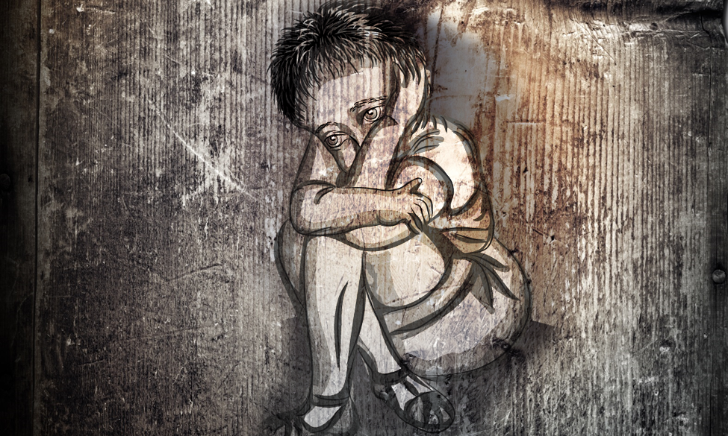
Poverty in childhood
Toxic stress derails healthy development
Ingimage.com

Slide 7
Pathways: poverty poor health
Material pathways: direct relation between what income can buy and health effects
Psycho-social pathways: indirect relation between income and health effects, mediated through variety of psychological/social mechanisms
  Allostatic load: chronic social and environmental stress
  Epigenetics

Slide 8
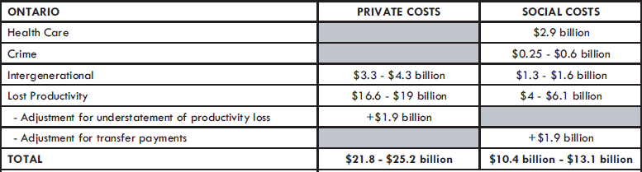
The Cost of Poverty in Ontario
Source: Ontario Association of Food Banks (2008) The Cost of Poverty: An Analysis of the Economic Cost of Poverty in Ontario

Slide 9
Who lives in poverty in Simcoe County?
6,310 (32% of) lone-parent families
17% of children 0-17 yrs.
3% of seniors 65+yrs.
13% of adults 18-64 yrs.
52,690 people
(12% of total population)
2,950 (19% of) pop’n with Aboriginal identity
780 (21% of) recent immigrants
14,450 (15% of) pop’n with activity limitations
Data Sources: Statistics Canada, Income Statistics Division, Annual Estimates for Census Families and Individuals [2012], 13C0016. Taxfiler Table F-18 Family data.
Statistics Canada, National Household Survey, Target Group Profile #10 - Recent Immigrants [2011], EO2065.
Statistics Canada. National Household Survey, Target Group Profile #11 – Aboriginal Identity [2011], EO2065.
Statistics Canada. National Household Survey, Target Group Profile #8 – Population with activity difficulties/reductions [2011], EO2065.

Slide 10

Voices of Poverty Experience
A County of Simcoe Initiative
“I know I need to get my high school, and it’s affecting my life, but how can I with no computer at home, no one to look after my kids and no money? There’s so much in the way.”
- Female, Orillia

Slide 11
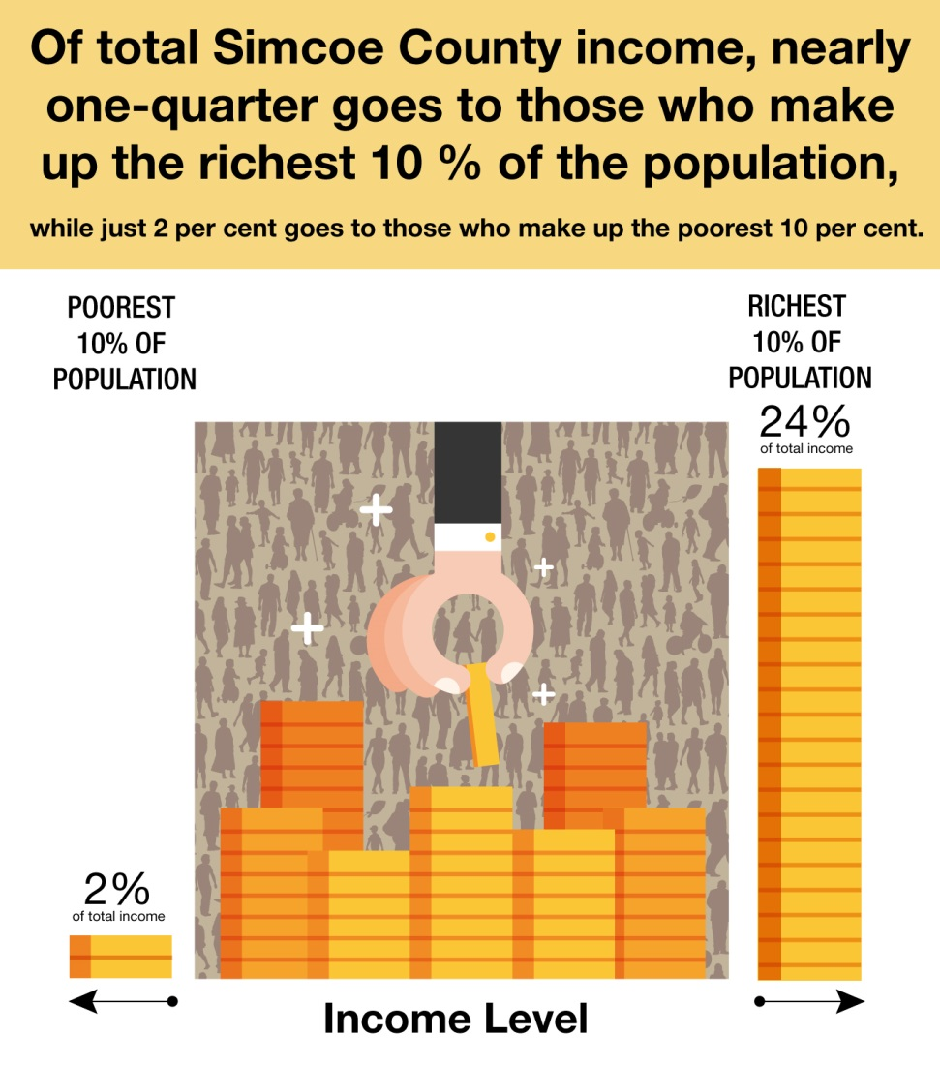
Income inequality
Data Source: Statistics Canada, Income Statistics Division, T1 Family Files [2011], Reference 15020.

Slide 12
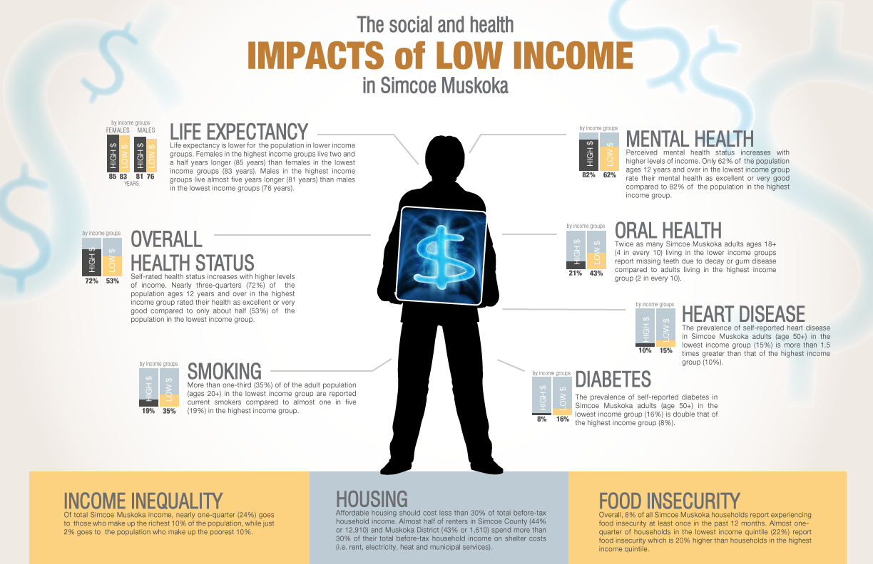
Health inequities

Slide 13
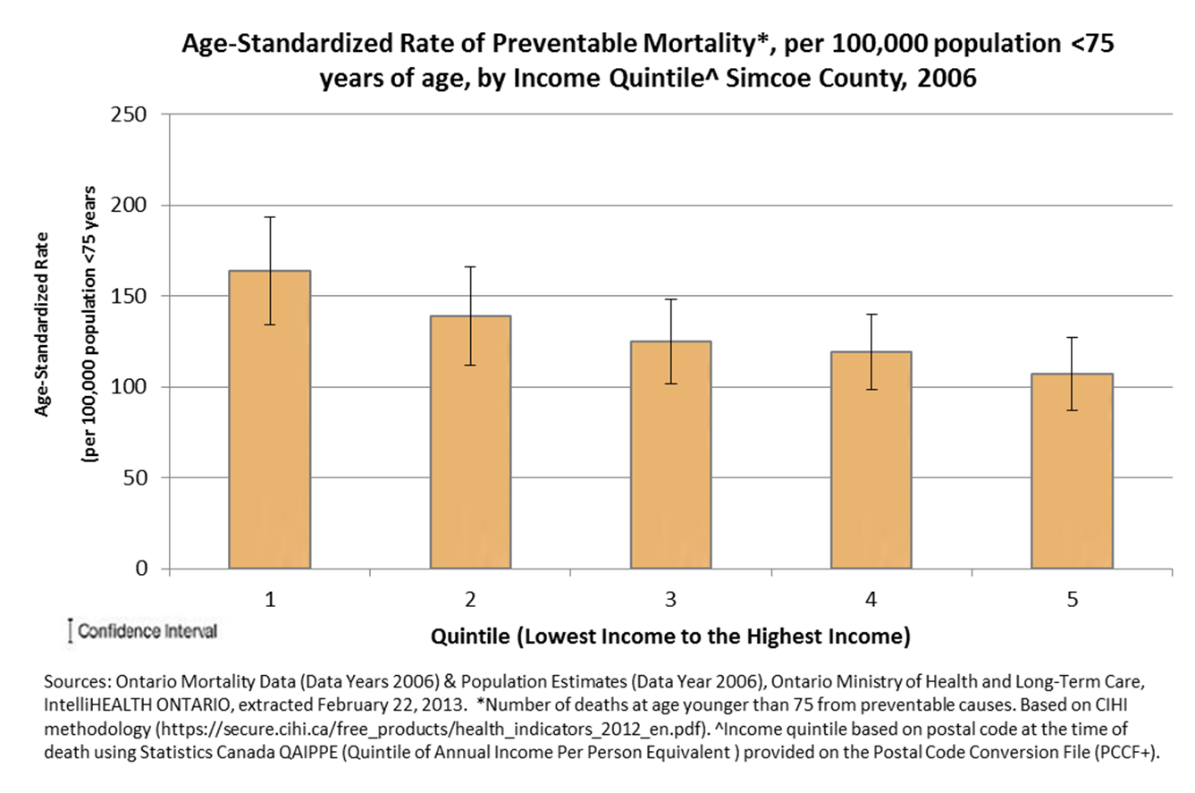
Preventable mortality

Slide 14
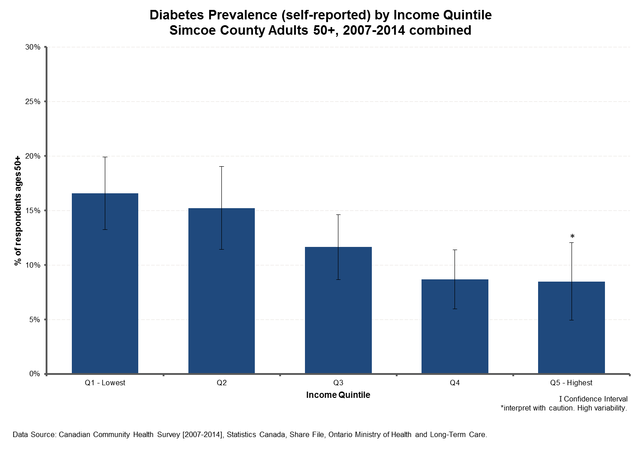
Diabetes

Slide 15
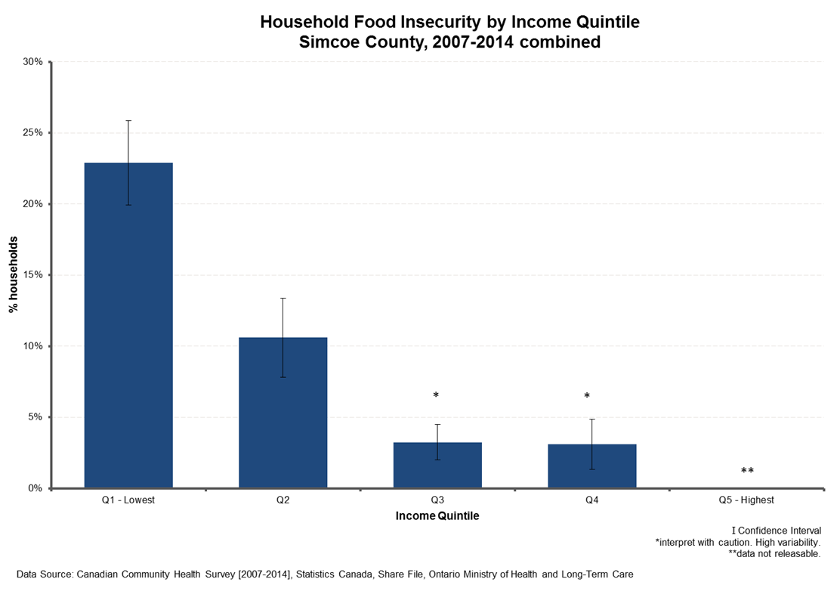

Food insecurity
9% of households in Simcoe County reported experiencing food insecurity at least once in the past year.
Data Source: Canadian Community Health Survey [2007-2014], Statistics Canada, Share file, Ontario Ministry of Health and Long-Term Care

Slide 16
Basic income guarantee

Slide 17
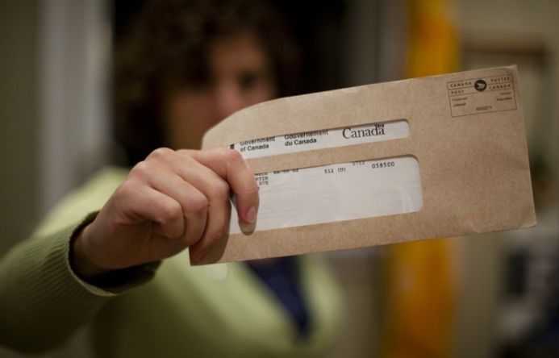

What is Basic Income?
Basic income involves a regular, reliable distribution of money from government to people to help ensure total income sufficient to meet common basic needs. It can be distributed on a universal basis (demogrant), or an income-tested basis using the income tax system.

Slide 18

Rationale For Basic Income
Poverty:
Basic income can be an effective, dignified, and efficient part of a comprehensive poverty reduction strategy.
Income inequality:
Basic income can help close the gap – in income, somewhat, and in personal opportunity and power.
Precarious labour:
Basic income can increase social security in a time of substantial labour market change and uncertainty.

Slide 19
Precarious Employment
Study of precarious employment in GTA-Hamilton found:
50% growth of precarious labour in 20 years
50% of workers working either full- or part-time with no benefits or job security, or in temporary, contract or casual positions
employment insecurity has an independent effect on household well-being and community connections, regardless of income level
Source: Poverty and Employment Precarity in Southern Ontario (PEPSO). It’s More than Poverty: Employment Precarity and Household Well-being. 2013.

Slide 20

Existing Programs Approximating Basic Income
Canada Child Tax Benefit
National Child Benefit Supplement
Ontario Child Benefit
Working Income Tax Benefit
Old Age Security
Guaranteed Income Supplement

Slide 21
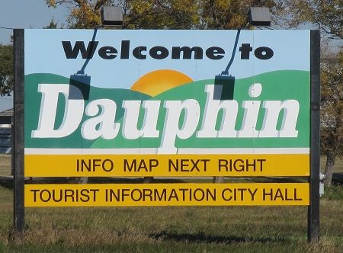
Manitoba Mincome Experiment 1974-1979
Canadian guaranteed annual income field experiment
8.5% decrease in hospitalization rates for participants vs. controls, and decline in physician contact
Increased high school completion
Minimal work disincentive
Source: Forget, E. The Town with No Poverty: The Health Effects of a Canadian Guaranteed Annual Income Field Experiment. Canadian Public Policy, Vol. xxxvii, No. 3, 2011.

Slide 22
Basic income and stigma
Calnitsky D. “More Normal than Welfare”: The Mincome Experiment, Stigma, and Community Experience. Canadian Review of Sociology (forthcoming):
“The design and framing of Mincome led participants to view payments through a pragmatic lens, rather than the moralistic lens through which welfare is viewed. Consistent with prior theory this paper finds that Mincome participation did not produce social stigma.”

Slide 23
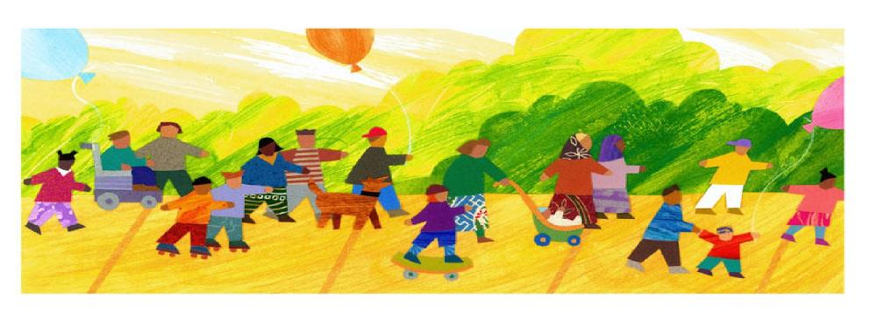
Impact of Child Benefits
Canada Child Tax Benefit and National Child Benefit Supplement
improved math and reading skills
improved child mental and physical health measures
Source: Milligan and Stabile, 2011

Slide 24
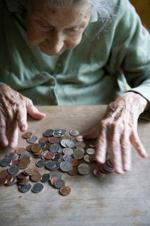
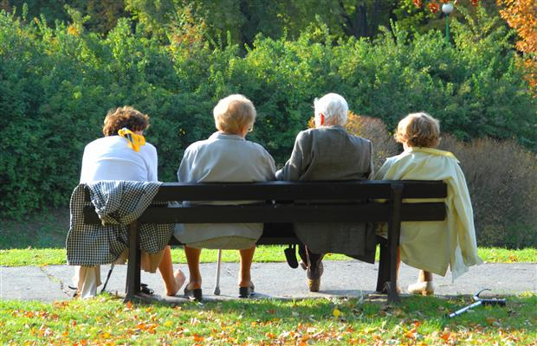
Impact of Seniors’ Benefits
Old Age Security & Guaranteed Income Supplement
Canada now has one of lowest rates of seniors poverty in world
When low-income Canadians leave workforce after turning 65, their poverty level drops substantially: 50% fewer experience food insecurity at aged 65-69 than 60-64
Source: Emery, Fleisch and McIntyre 2013

Slide 25
Key Questions & Debates in BI design
What is the purpose of the Basic Income Guarantee (BIG)?
What programs should it replace?
Maximum amount of the BIG?
Demogrant and/or negative income tax?
If negative income tax, what is the reduction rate?
Eligibility: who may receive it?
Adjustment in BIG amounts based on family/household size?
Frequency of income payments?
Sources of revenue to fund the BIG?
What level of government to deliver?

Slide 26
Affordability of a BIG
Cost of a BIG depends on: how generous it is, how quickly benefits are phased out with additional income earned, and how existing social programs are affected
Estimated costs in addition to current social spending:
  $17 - $58 Billion (Roos and Forget, U of Manitoba)
  $40 Billion (Boadway and Power, Queen’s U)
Estimated annual cost of poverty in Canada: $79 to $95 billion (2014 $)
  Factoring health, crime, intergenerational and lost productivity costs
  (Source: Ontario Association of Food Banks (2008) The Cost of Poverty - figures extrapolated from the report’s estimate of $72-$86 billion in 2008 $ x inflation since then)

Slide 27
Big Momentum

Slide 28
Support for basic income
Supported by generations of economists and social policy experts, across the political spectrum
Resurgence of public support in recent years
International pilots and programs, most recently:
  Finnish government pursuing basic income
  Dutch cities basic income experiment

Slide 29
Health sector support for basic income in Canada
Alberta Public Health Association, 2014
Association of Local Public Health Agencies (Ontario), 2015, and several local Boards of Health
Canadian Medical Association, 2015
Canadian Public Health Association, 2015
Ontario Public Health Association, 2015
194 Ontario physicians signed letter to ON Minister of Health & Long-Term Care, 2015
Also: Canadian Association of Social Workers; Food Secure Canada; Community Food Centres of Canada; and more

Slide 30
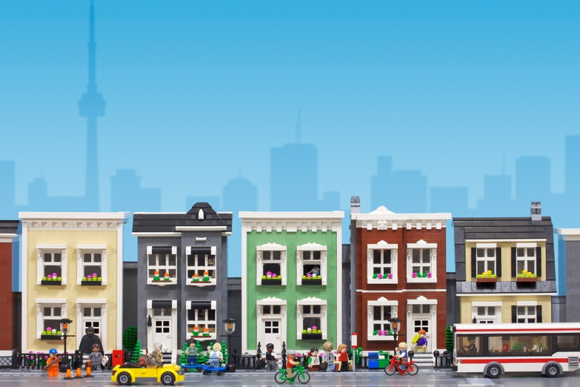
Growing public & political support
for basic income in Canada
Federal political party resolutions
Provincial politicians in PEI, Alberta, and elsewhere
Positive meetings with several ON provincial officials
Municipal and regional council motions
Support from mayors of large and small communities
Local & regional basic income support groups
Prominent Canadians

Slide 31

Local advocacy opportunities
Community engagement
Seek support of local politicians/ councils
Advocate to MPs and MPPs
Public awareness

Slide 32
Acknowledgements
Rob Rainer, Basic Income Canada Network

Slide 33

谢谢
Gracias
Miigwetch
Takk
Thank you
Dankie
Mahalo
Dziękuję
Spacibo
Merci

Slide 34
